Slide 1
Mary Joy Garcia-Dia, DNP, RN, FAAN
Notes:
To use this title animation slide with a new image simply 1) move the top semi-transparent shape to the side, 2) delete placeholder image, 3) click on the picture icon to add a new picture, 4) Move semi-transparent shape back to original position, 5) Update text on slide.

Slide 2
CELEBRATE
To perform (a sacrament or solemn ceremony) publicly & with appropriate rites
To honor an occasion (holiday)
To mark something (anniversary) by festivities or other deviation from routine
To observe a holiday, perform a religious ceremony or take part in a festival
To observe a notable occasion with festivities
Synonym: Keep, Observe, Commemorate
Latin Celebrat from the verb celebrare from celeber, celebr - “frequented or honored”

Slide 3
“IF YOU WANT SOMEONE TO REMEMBER YOUR MESSAGE – IN A PRESENTATION, AN ARTICLE, OR A REPORT–
TELL THEM A STORY.”
—RACHEL GILLETT, FAST COMPANY

Slide 4
STORIES OF PEOPLE, ACHIEVEMENTS, RESILIENCE, KINDNESS| SPARK.
WHY
The narrative technique grounds our own story on why we do what we do.
Creates a framework and means of connection with other works.
Leaves a lasting impression long after the story is done.

Slide 5
2006 SENTOSA STORY
Notes:
Tip:
When using complex image as full-bleed background add a transparency (70%-90%) fill layer to give contrast to text.

Slide 7
Acknowledge ( a significant or happy day or event) with social gathering or enjoyable activity
Reach (a birthday or anniversary)
Perform ( a religious ceremony) publicly and duly, in particular officiate at (Eucharist)
Honor or praise publicly
Oxford Dictionary
Notes:
Acknowledge – celebrate our achievements – National , Regional, Local
Reach - celebrate our 40th anniversary
Perform – Sunday Mass
Honor or praise publicly – Celebrating the nurses’ career

Slide 8
Acknowledge
A significant or happy day or event with social gathering or enjoyable activity
Reach
A birthday or anniversary
Perform
Praise publicly
Honor
A religious ceremony publicly and duly, in particular officiate at (Eucharist)
Oxford Dictionary
Notes:
Acknowledge – celebrate our achievements – National , Regional, Local
Reach - celebrate our 40th anniversary
Perform – Sunday Mass
Honor or praise publicly – Celebrating the nurses’ career

Slide 9
HOW DO WE UNITE 160,000 FIL-AM NURSES IN THE US AND COLLABORATE WITH 20 MILLION NURSES?

Slide 10
STORIES OF PEOPLE
2020 YEAR OF THE NURSE AND MIDWIFE

Slide 11
Our Stories
ACKNOWLEDGE
#yon2020
Why we belong
Notes:
Recent turnover in July 2020

Slide 12
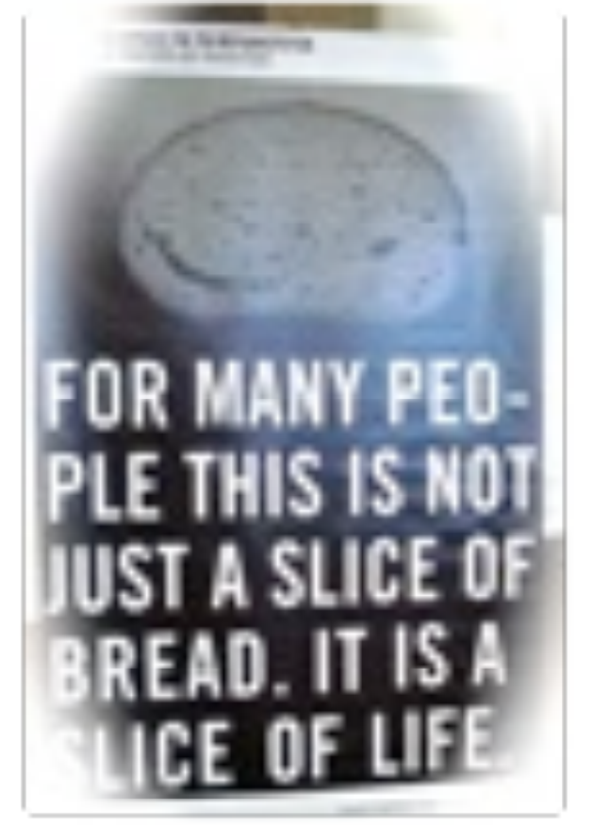
PNAA Leadership and Advocacy Work
Issues of Filipino Nurses as Immigrants
Low passing rates – 10%
Unrealistic 6 months Interim Permit → Deportation; discriminatory hiring practices
Narciso & Perez Case accused of causing deaths of 11 patients; Verdict Overturned
5-yr H1 Visa Limit Expiration
Exploitation by recruiters
Unfair Staff Scheduling
Difficulties w/ cultural adaptation & language
1960’s – Foreign Graduate Nurse
Exchange Scholar Program
Racial tension 1970’s
Nurse Relief Act 1989
THE CODE – 2008
Ethical Recruitment of
FEN (Foreign Educated Nurses)
PRESENT

Slide 13
PNAA LEADERS 1979 -1996
FGN Issues
Visibility with ANA & other Professional Organizations
Human Rights
Unified Filipino Nurses under PNAA
Nursing Shortage
Nurse Relief Act 1989

Slide 14
PNAA LEADERS 1986-2012
Give Back to Community:
Medical Missions
Balik-turo
Gawad-Kalinga
Learning Organization - CEs
Structure
Governance
- NCLEX
- The CODE

Slide 15
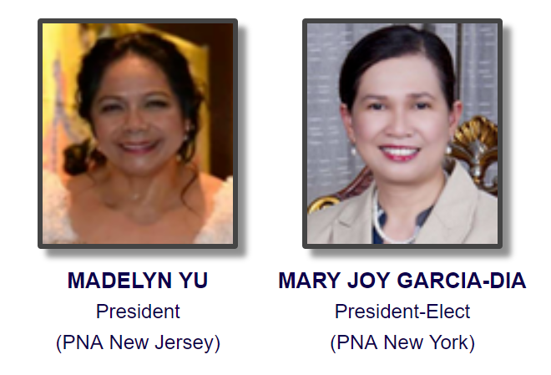
PNAA LEADERS 2012-2020
Social Activism
Future of Nursing
Innovation
Advocacy
Storytelling
2018-2020
PNA New Jersey
2020-2022
PNA New York

Slide 16
Our Achievements
REACH
#yon2020
Why we stay

Slide 17
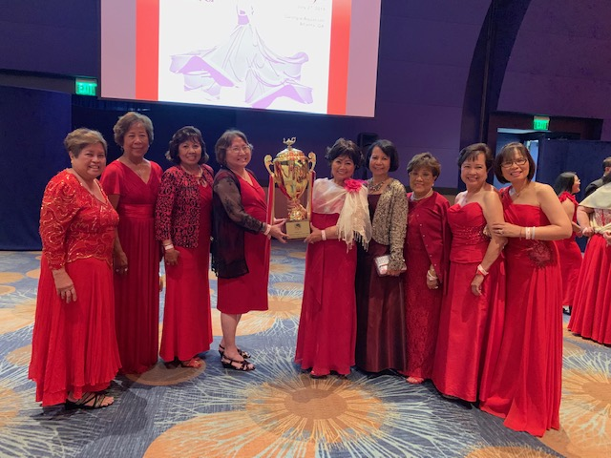
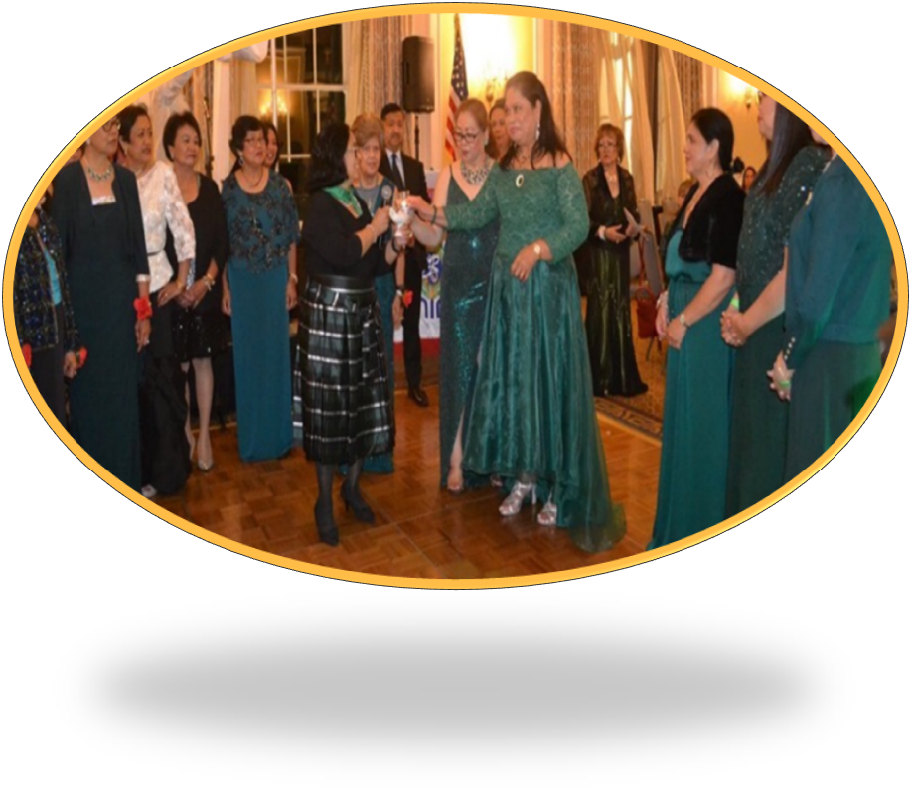
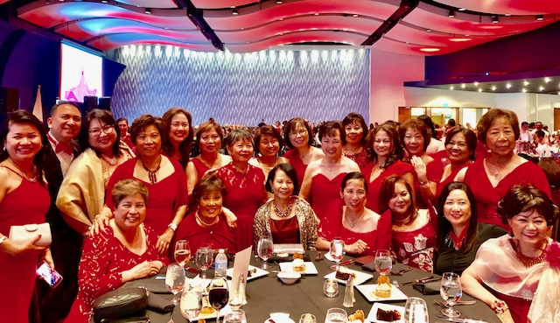
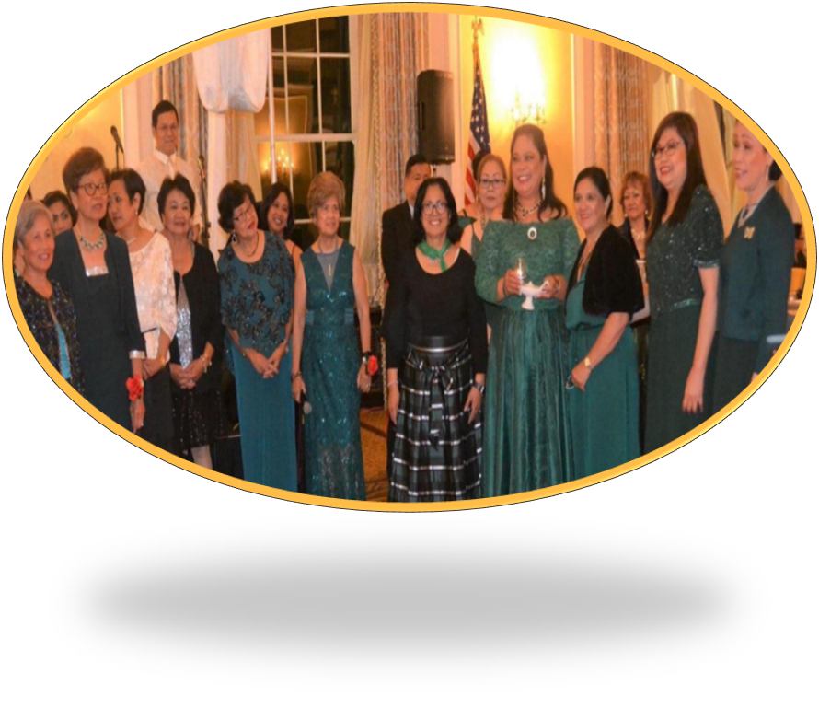
Celebrating 40+ Years
PNA SAN DIEGO
PNA NEW ENGLAND

Slide 18
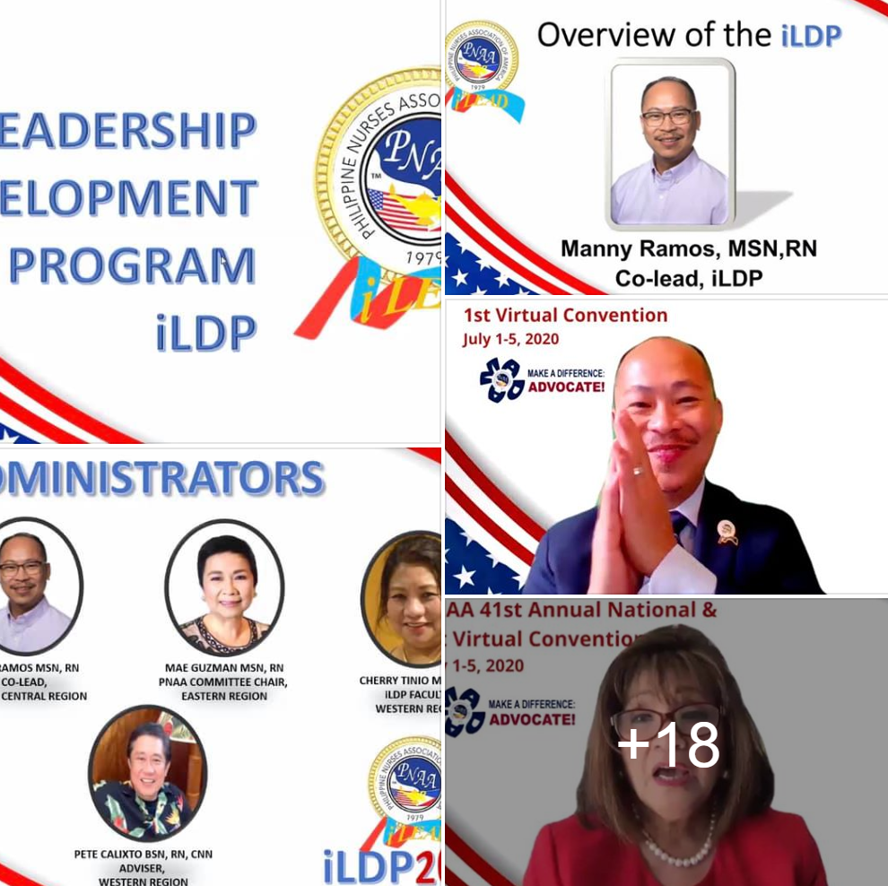
STORIES OF ACHIEVEMENT
LEADERSHIP DEVELOPMENT
MASTERCLASS WORKSHOPS
DATABASE: SPEAKER’S BUREAU
PNAA EDUCATION AND LEADESHIP PROGRAMS

Slide 19
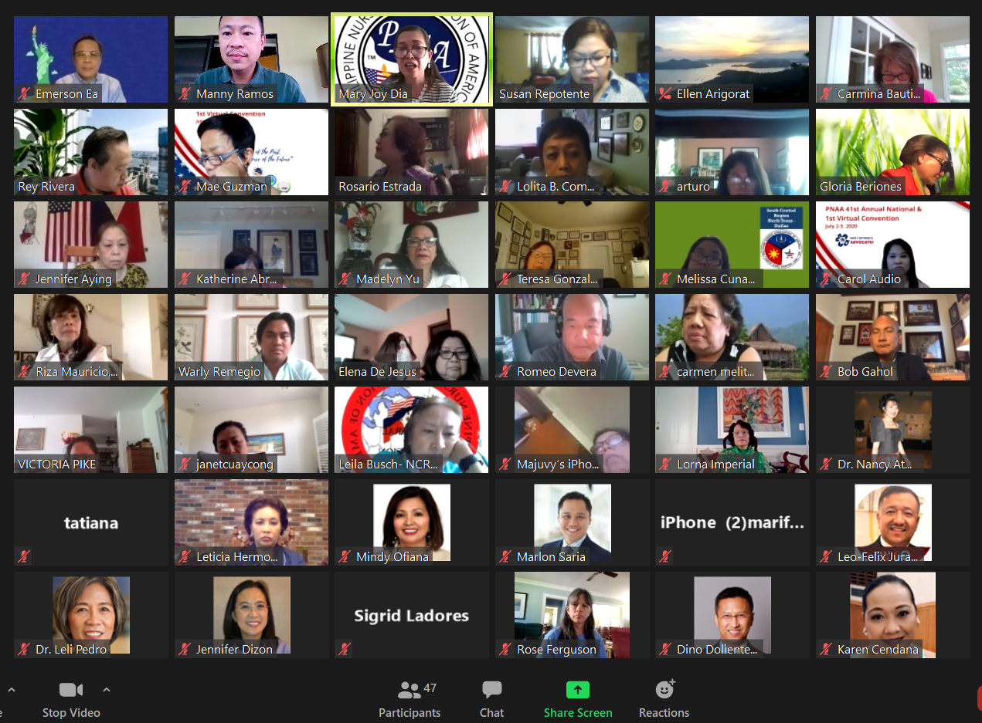
Part 1 – 6/20
Part 2 – 7/5
SOAR Strategic Planning Meeting

Slide 20
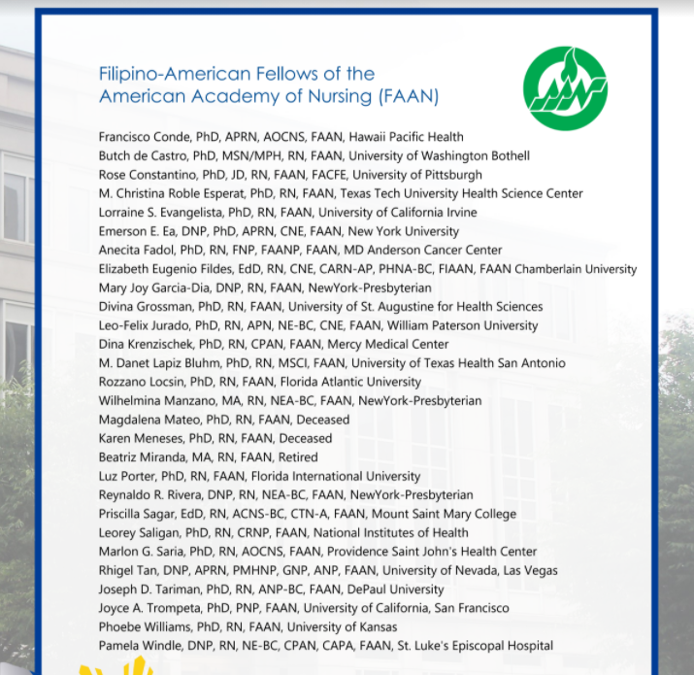
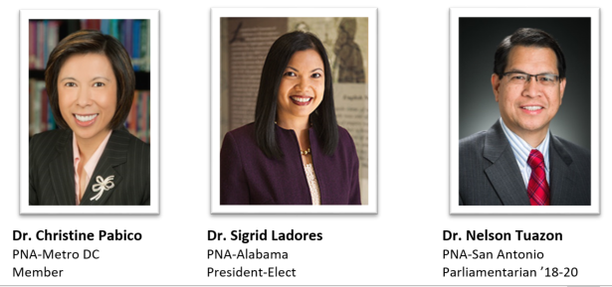
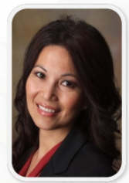
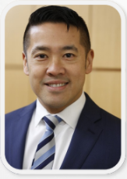
Fellow of the American Academy of Nursing 2020
Dr. Alona Angosta
AAPINA Past President
Dr. Jeffrey Kwong
Professor Rutgers University
BEYOND STORIES OF ACHIEVEMENT

Slide 21
Our Resilience: PNAA AMIDST COVID-19
PERFORM
#yon2020
Why we persevere

Slide 22
STORIES OF RESILIENCE
COVID-19 Task Force

Slide 23
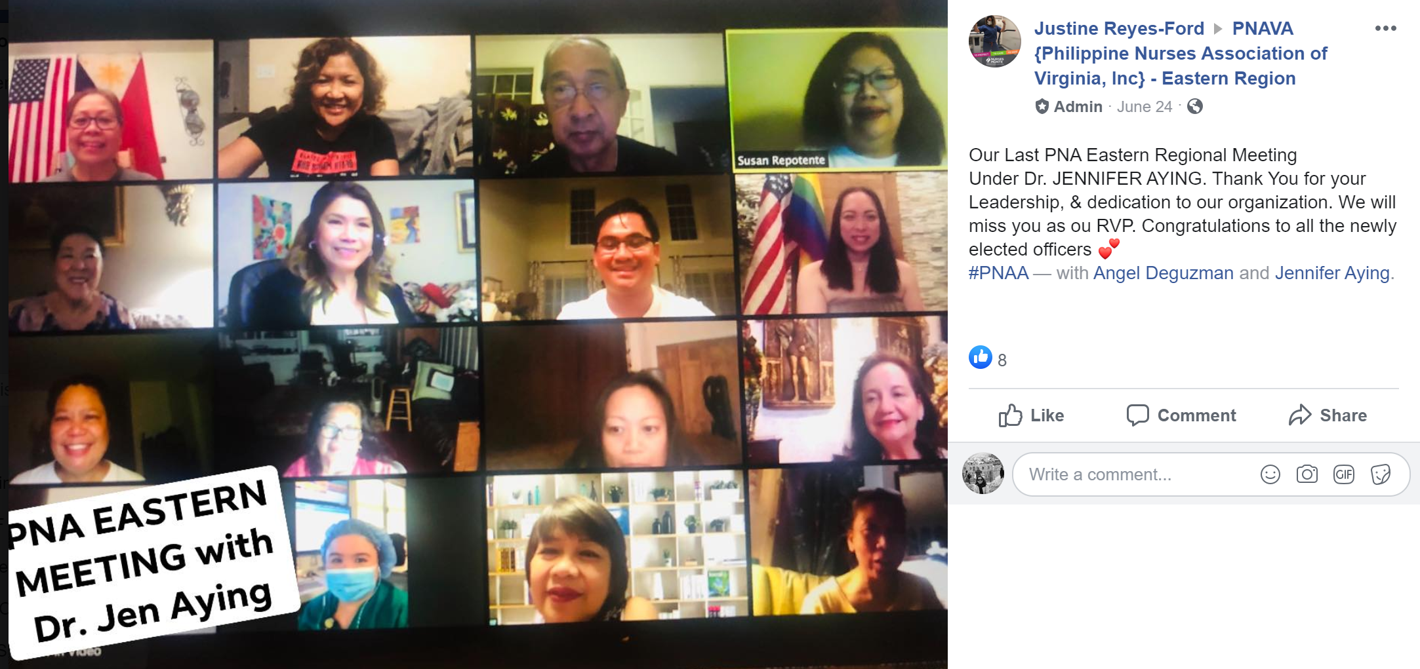
BEYOND STORIES OF PEOPLE
Topics:
Meet chapter leaders
Dialogue with our Millennials
CNO in our Region
Townhall with our RVPs
Recipe for Thanksgiving
Virtual Salo-Salo

Slide 24
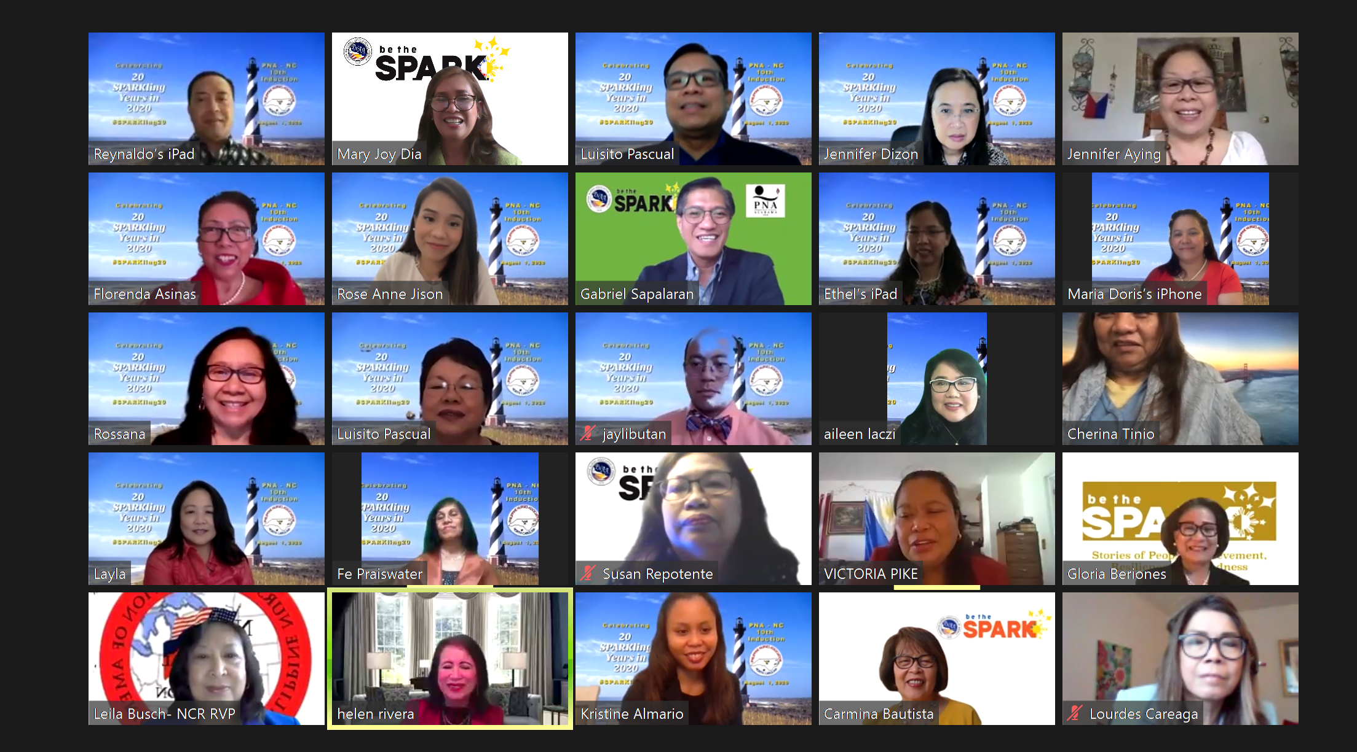
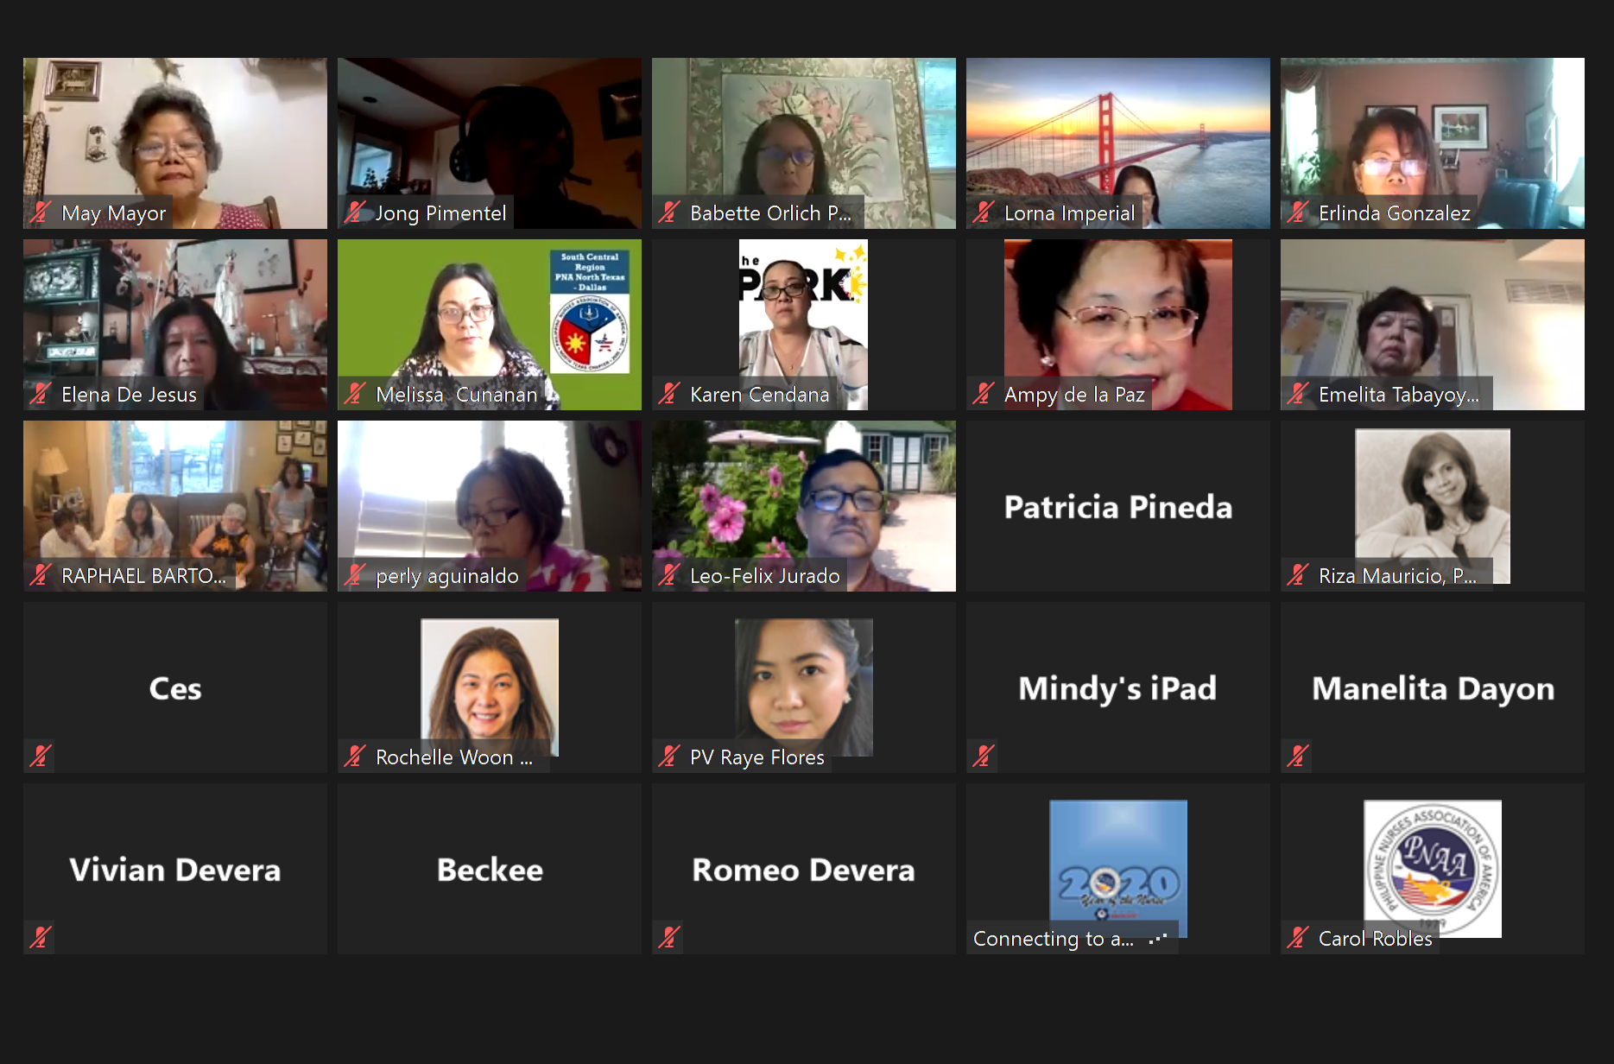
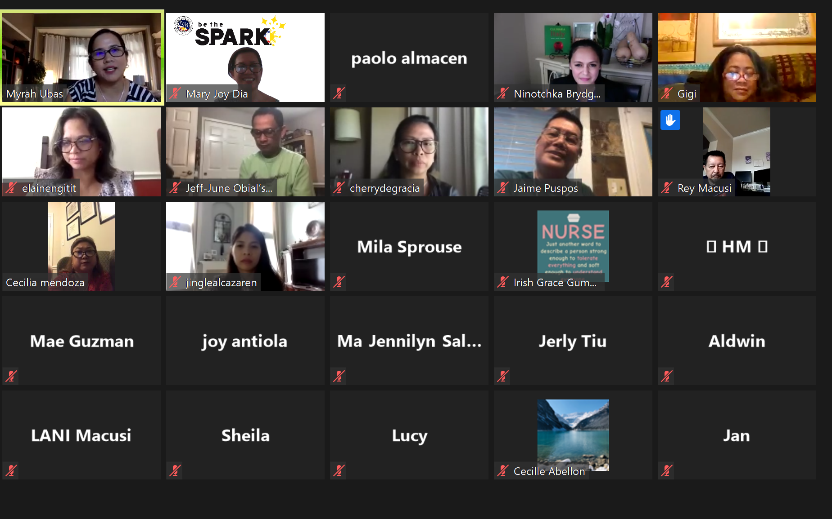
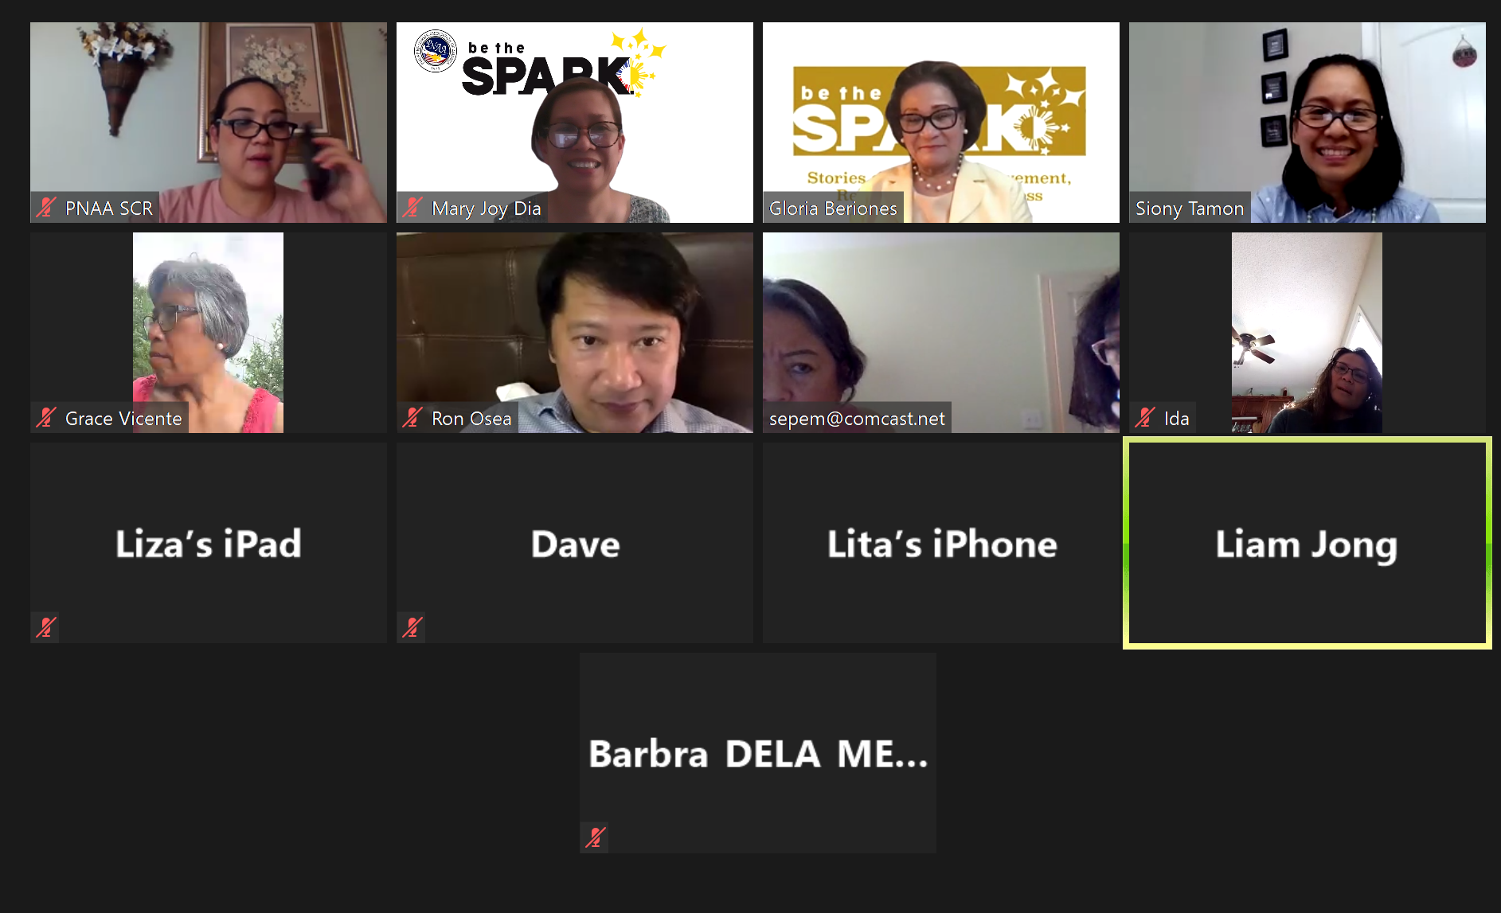
VIRTUAL INDUCTIONS: PNA LOCAL CHAPTERS

Slide 25
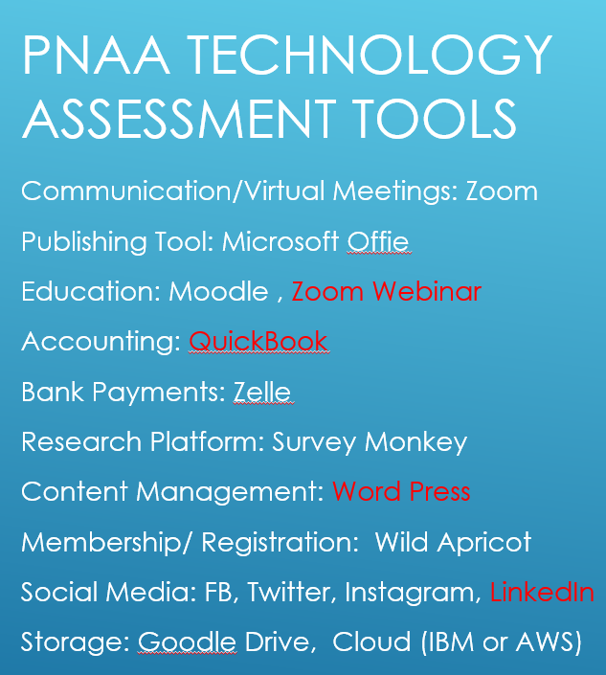
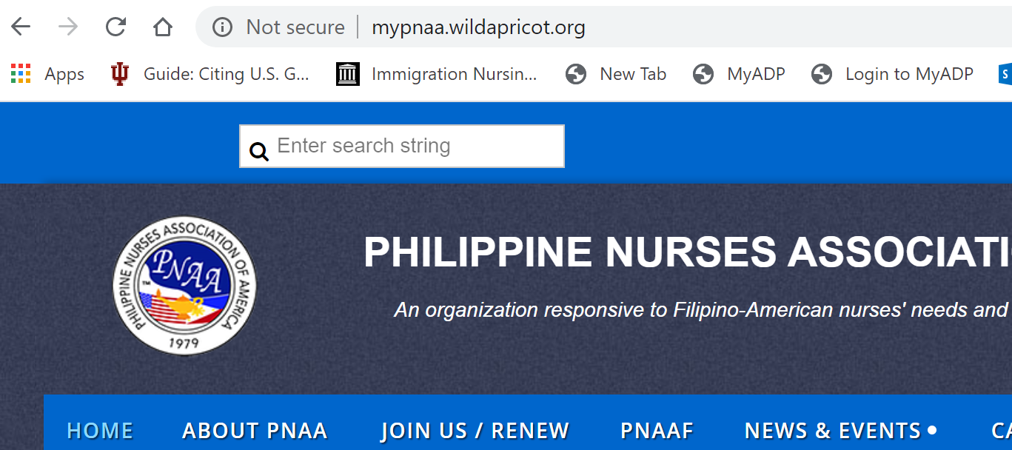
REIMAGINE
REVENUE
RESOURCE
RESILIENT WORKFORCE

Slide 26
Our Kindness: HEAL OUR NURSES
HONOR
#yon2020
Why we care

Slide 27
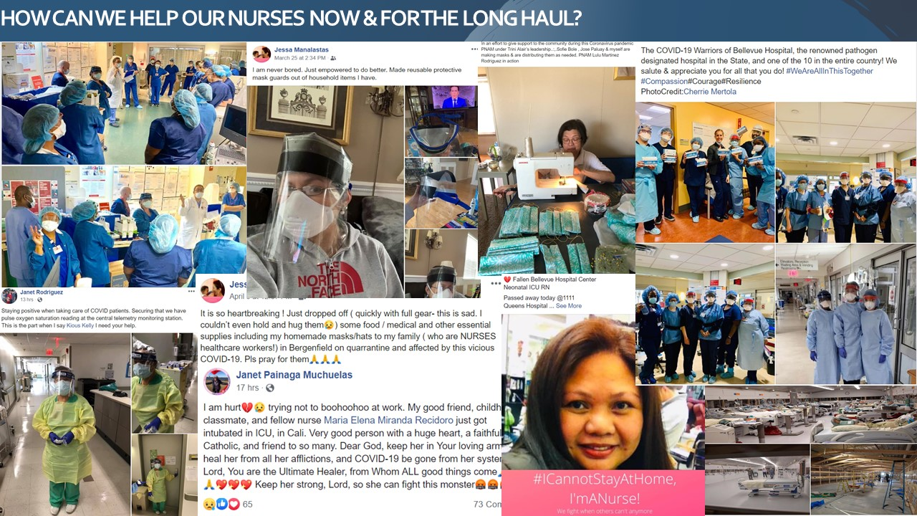
STORIES OF KINDNESS
OUR PNAA CHAPTER MEMBERS

Slide 28
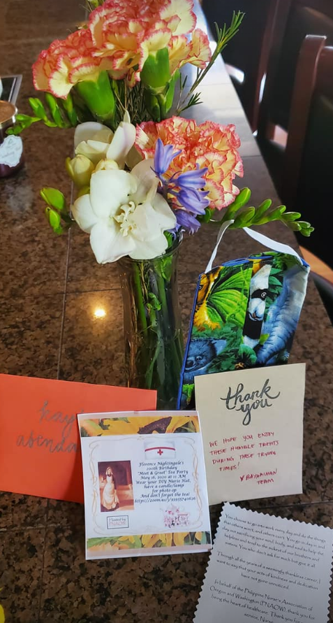
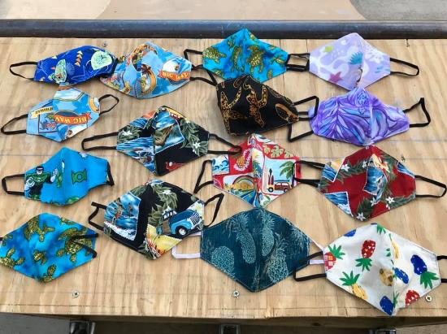
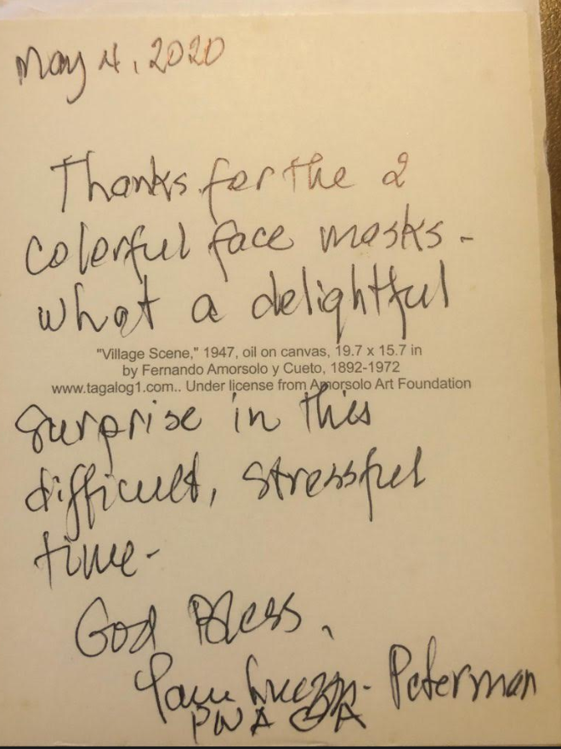
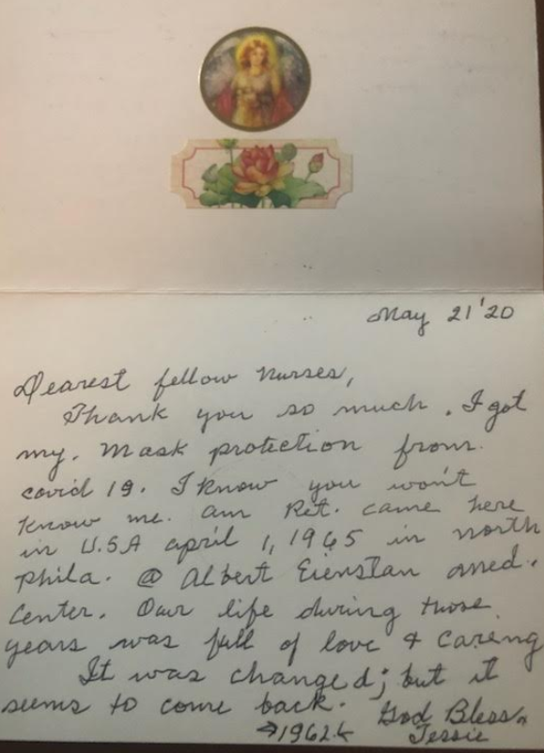
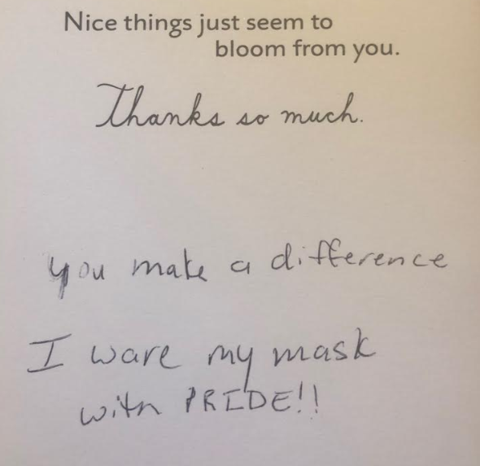
STORIES OF KINDNESS
GRATEFULNESS

Slide 29
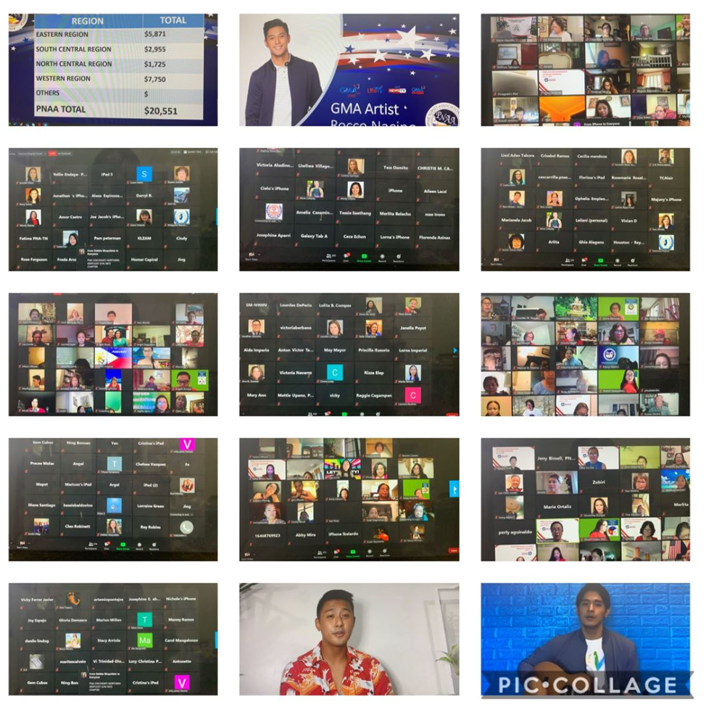
BEYOND STORIES OF KINDNESS
VIRTUAL FUNDRAISING

Slide 30
BECAUSE STORYTELLING, AND VISUAL STORYTELLING, WAS PUT IN THE HANDS OF EVERYBODY,
WE HAVE ALL NOW BECOME STORYTELLERS.
—LEVAR BURTON

Slide 31
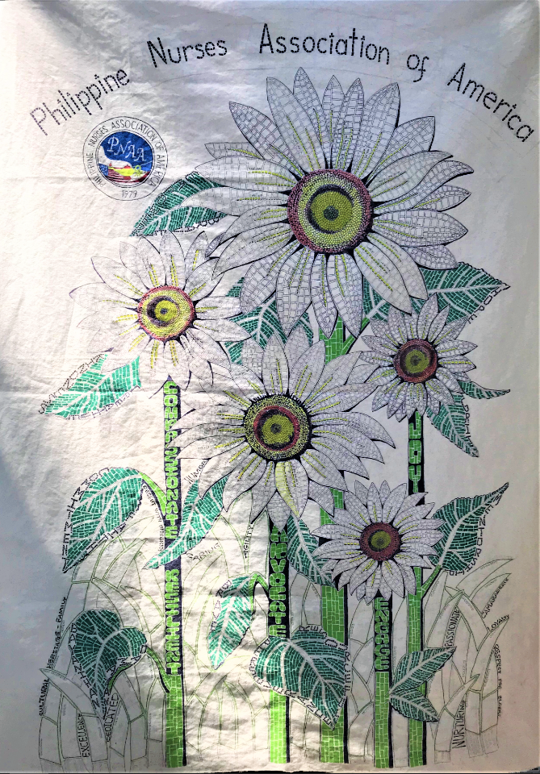
BEYOND THE COVID-19 STORY
Travelling Historian & Journal
Advocate | Heritage
Agility | Hope
Bayanihan | Joy
Brave | Kindness
Camaraderie | Loyalty
Caring | Mentorship
Compassionate | Nurturing
Commitment | Passionate
Creative | Perseverance
Damayan | Resilient
Decent with Integriy | Respect for Elders
Empower | Resourceful
Engage | Sense of Humor
Excellence | Sense of Family
Faith | Volunteerisn
Grit
What is your Spark?

Slide 32
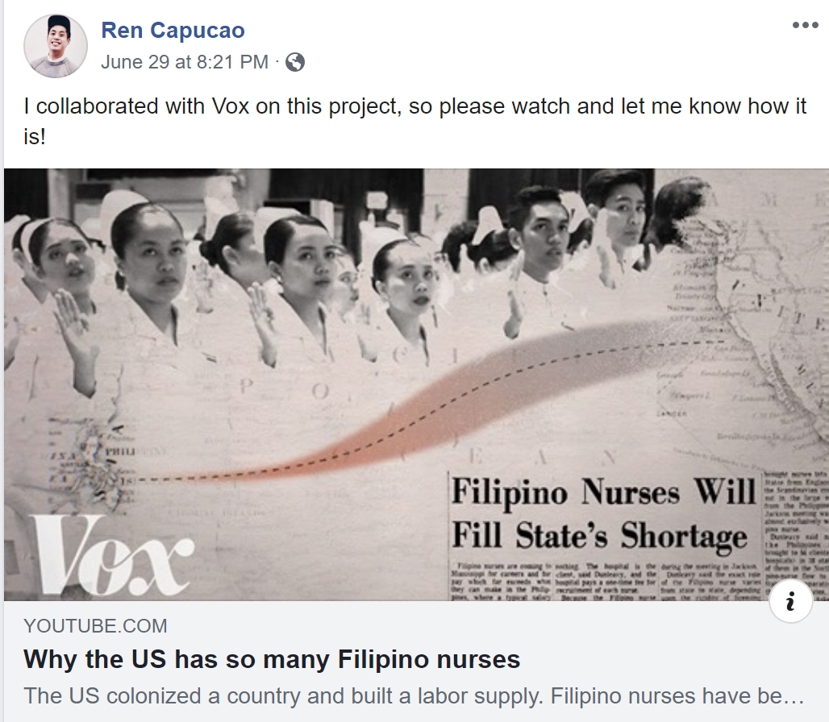
BEYOND STORIES OF PEOPLE
DIGITAL NARRATIVE: VIDEO
BOOK: HISTORY OF PNA CHAPTERS
History of PNAA’s 55 Chapters

Slide 33
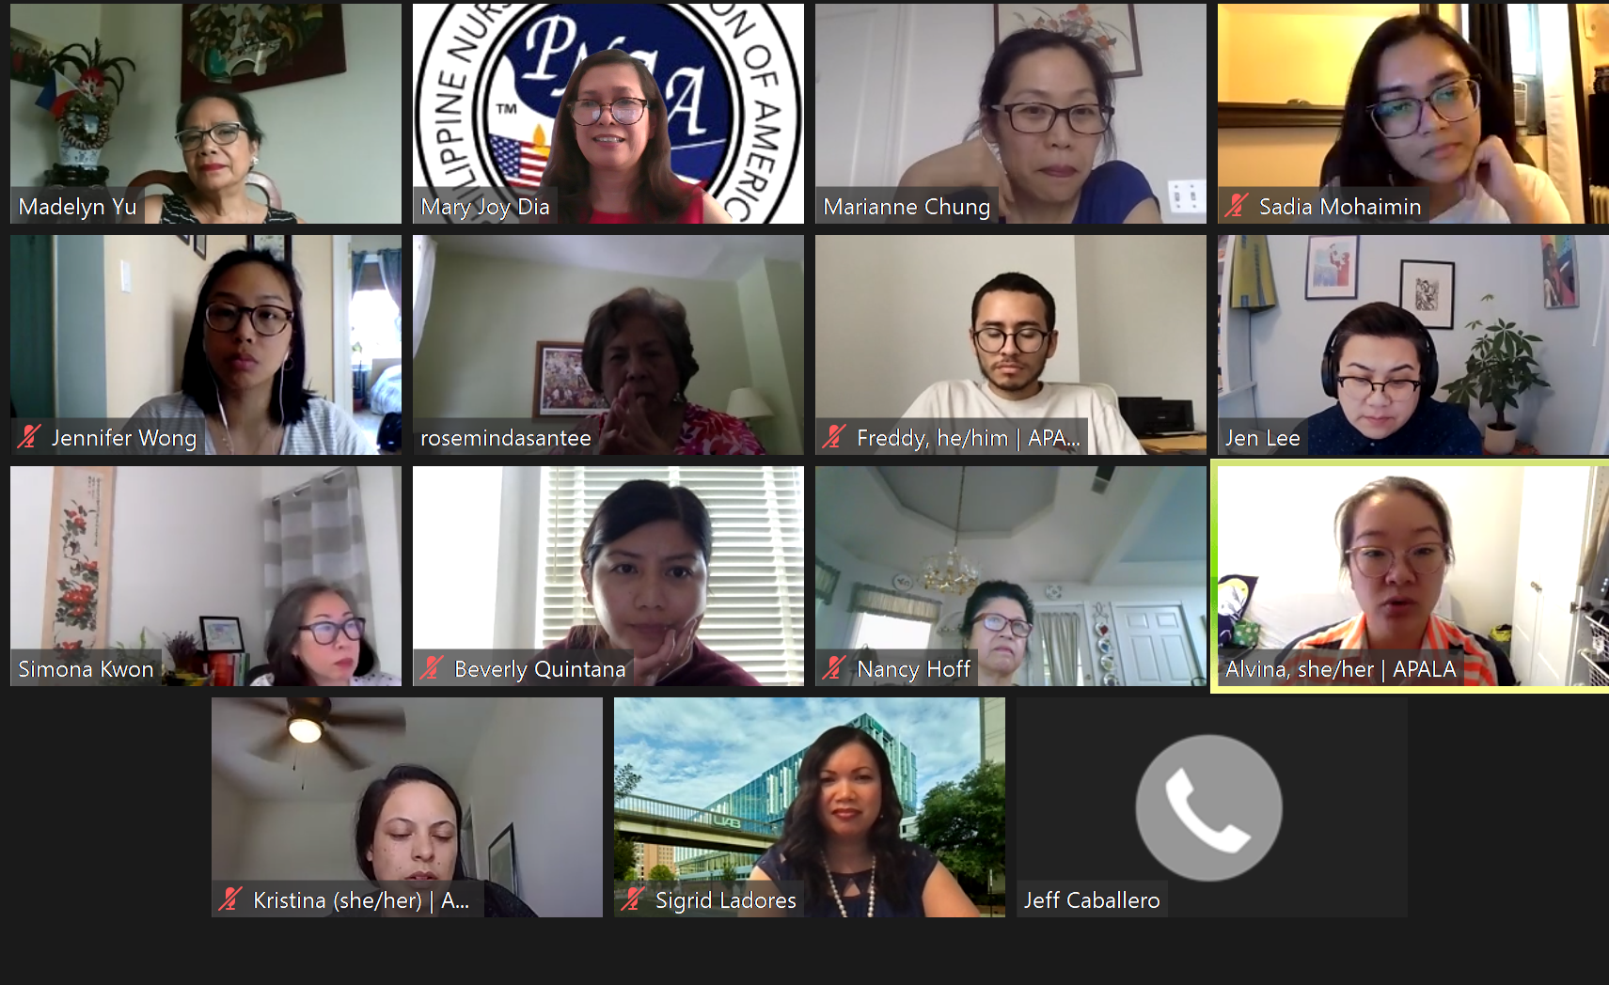
BEYOND STORIES OF RESILIENCE
Kick-off Meeting with APIAHF Together with PNAA and PNAAF
COVID-19 TASK FORCE: TEAM RESILIENCE

Slide 34
STORIES OF RESILIENCE
Expand Mag-PCOR Muna Tayo in Partnership with
Community Based Organization thru PNAA Governance
MINORITY HEALTH AND PATIENT: COMMUNITY RESILIENCE

Slide 35
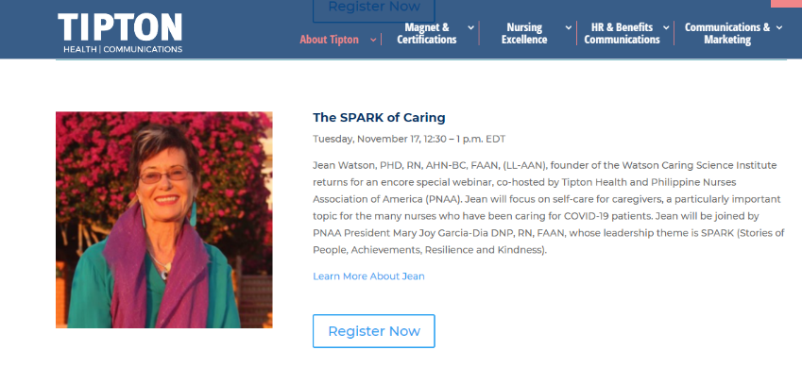
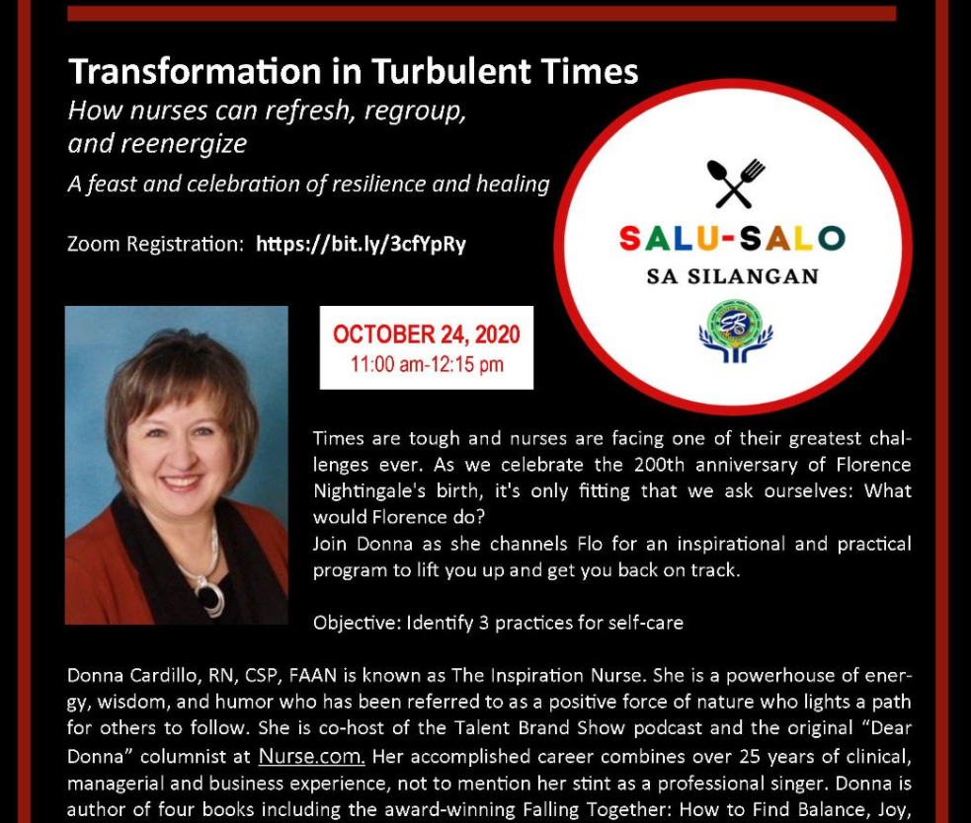
BEYOND
STORIES OF KINDNESS

Slide 36
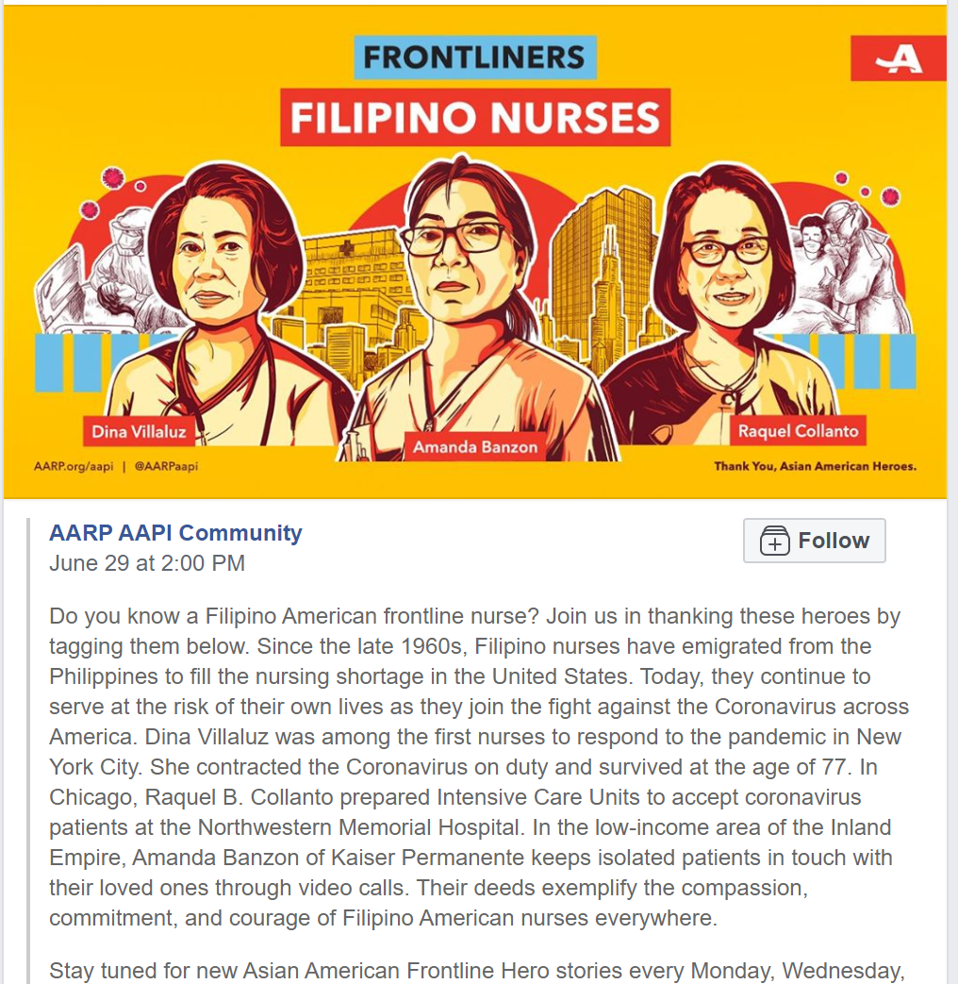
BEYOND STORIES OF KINDNESS
IMAGE OF THE FILIPINO NURSE
ECONOMIC AND SOCIAL IMPACT

Slide 37
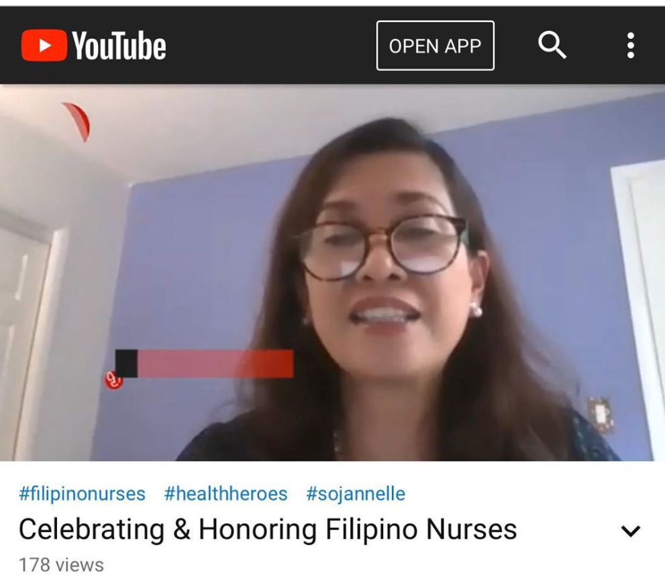
BEYOND STORIES OF KINDNESS
DIGITAL NARRATIVES

Slide 38
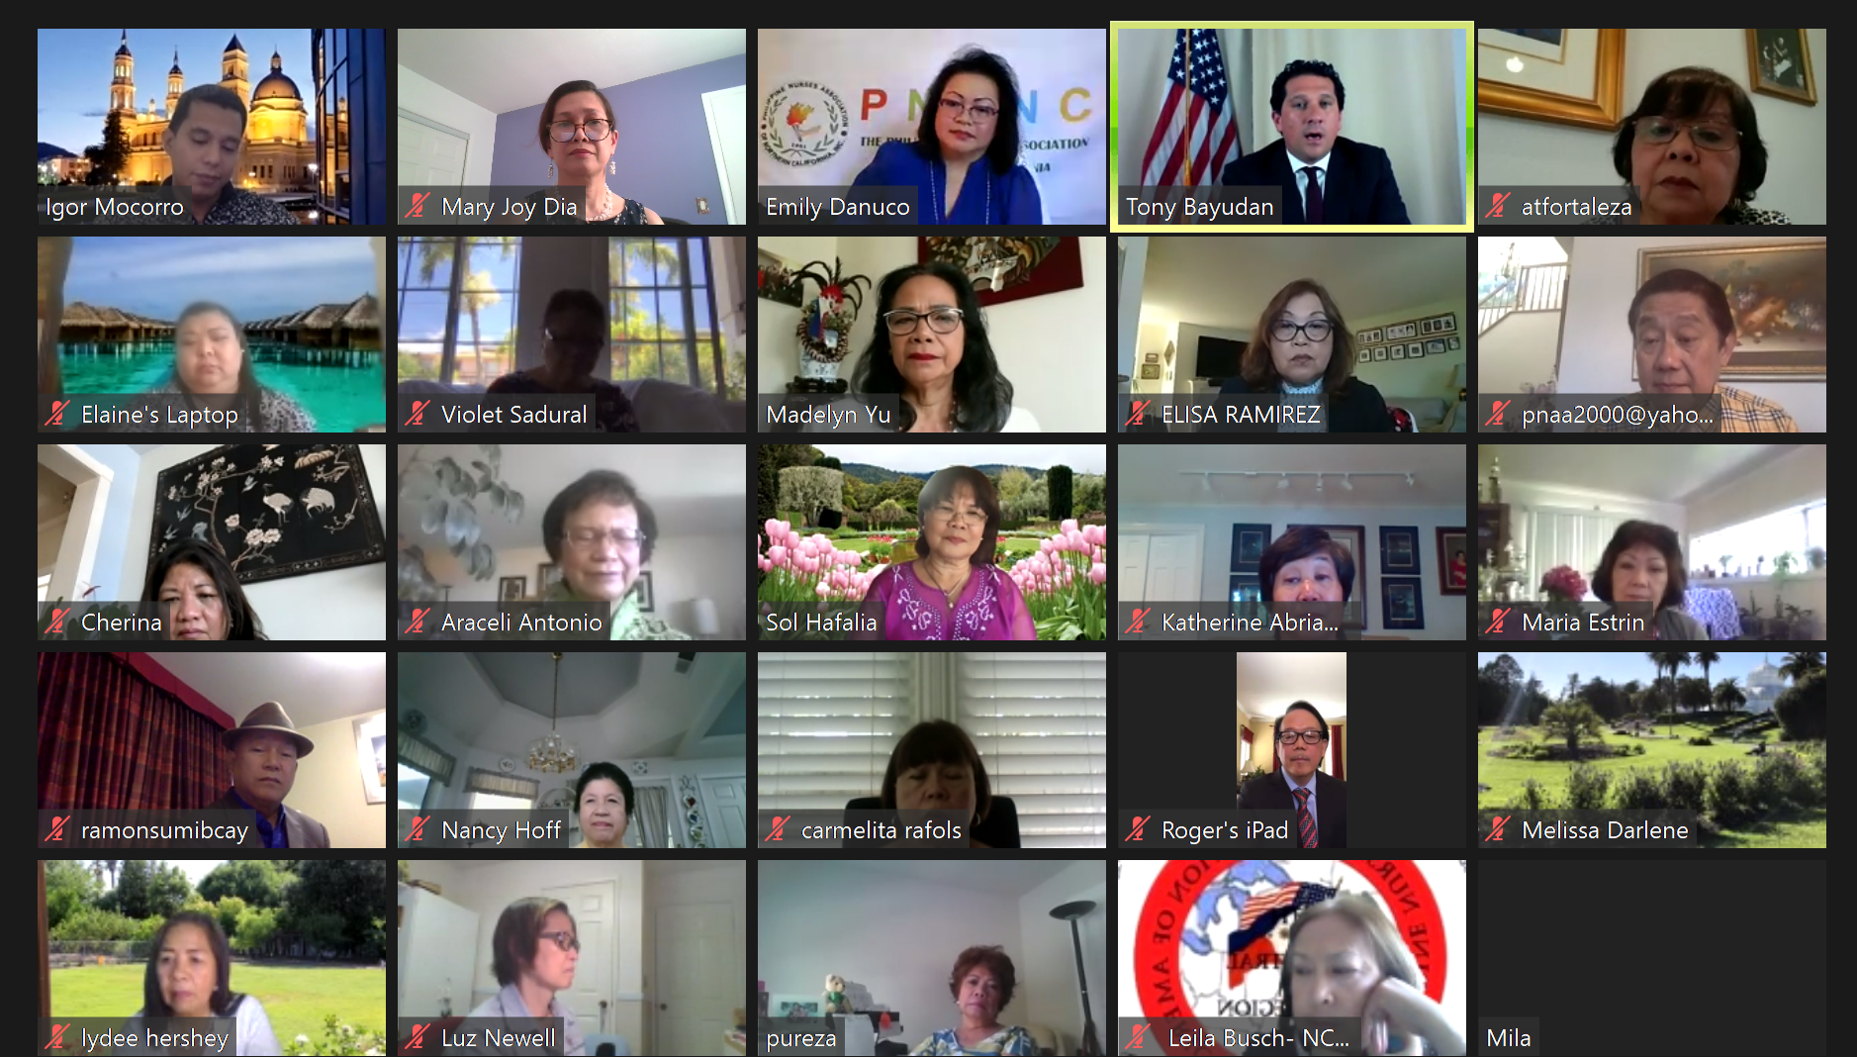
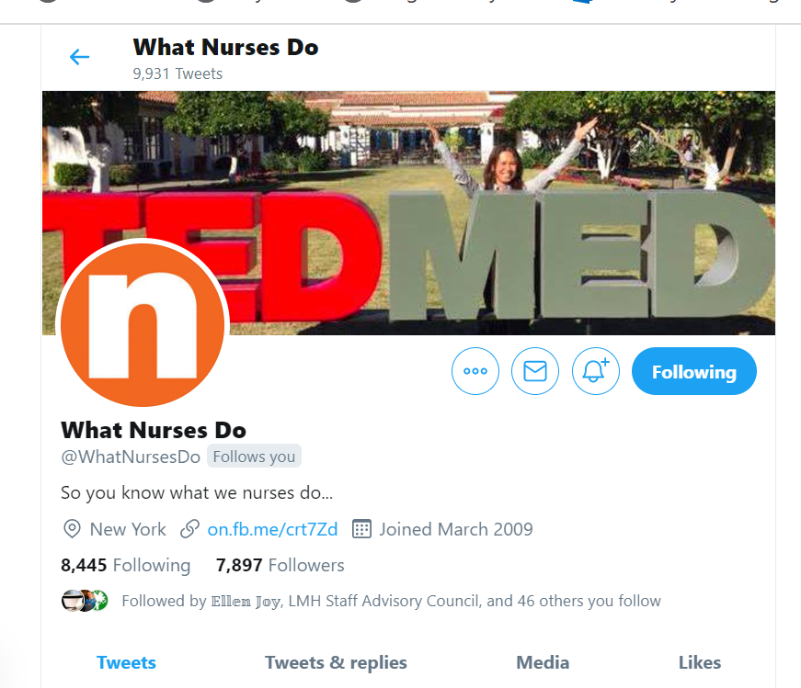
BEYOND STORIES OF KINDNESS
THE HASHTAG #WeAreAllInThisTogether
DIGITAL LEADERS

Slide 39
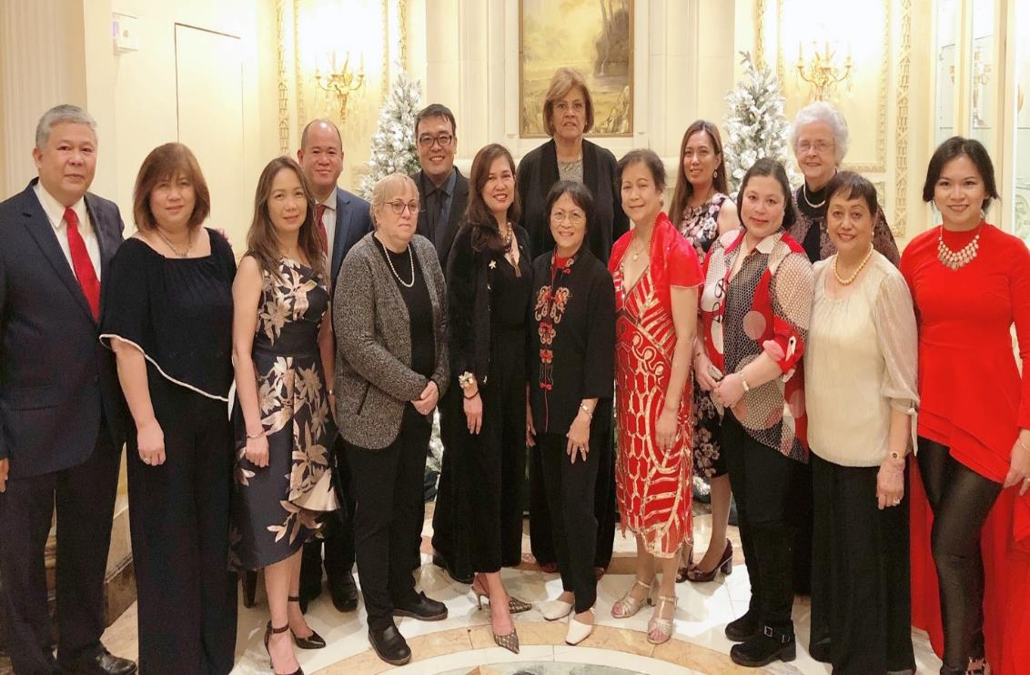
SHARE
Your story
SPARK
Role Model
EMPOWER
Mentor
Stories of People, Achievements, Resilience, Kindness
Notes:
Combine an image and multiple key statements with a strong grid.

Slide 40
Thank you!
Spark. Empower

Slide 41
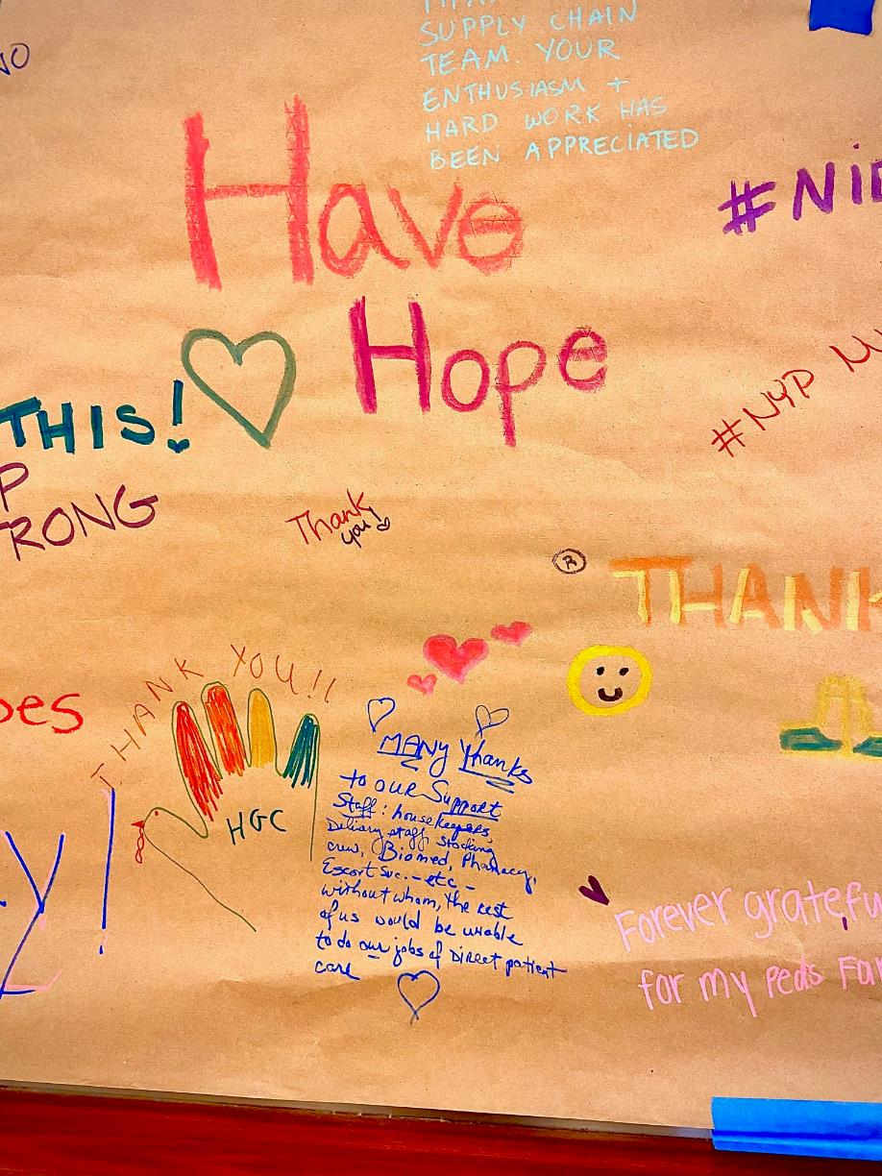
Beyond our stories.
https://www.youtube.com/watch?v=LNLsVG3DMlo

