Slide 1
2020 Year of the Nurse: Celebration of Heroism, Resilience and Healing
Thursday, October 29, 2020
Harold Cruz Sarmiento, AGPCNP-BC, MSN, AAHIVS, HIV PCP, CCRN-CMC, CMSRN Infectious Disease Nurse Practitioner
Doctor of Nursing Practice Student
University of California, Los Angeles

Slide 2
Disclosures: None

Slide 3
Objectives:
Describe the professional nurse’s view of heroism during this time of pandemic
Discuss the emotional baggage of the professional nurse as they deal with daily demands on the frontlines
Relate the pandemic climate to the general professional nursing core of practice

Slide 4
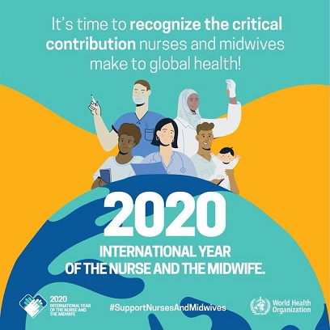
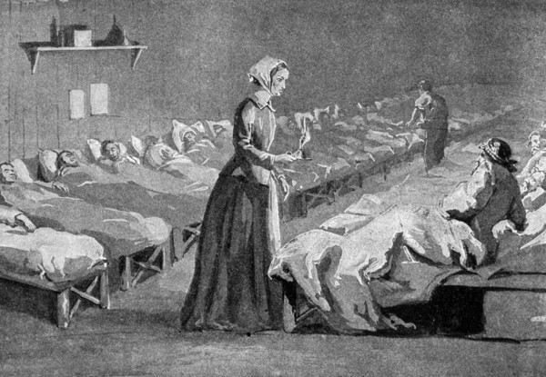
Introduction and Background
WHO designated 2020 as the Year of the Nurse and the Midwife.
This is in celebration of Florence Nightingale – the icon of modern nursing’s 200th birthday. Florence would be proud of you.
Nursing now focuses on five core areas: ensuring that nurses and midwives have a more prominent voice in health policy-making; encouraging greater investment in the nursing workforce; recruiting more nurses into leadership positions; conducting research that helps determine where nurses can have the greatest impact; and sharing of best nursing practices
Notes:
It could not be more timely that World Health Organization designated 2020 as the International Year of the Nurse and the Midwife.
Whereas nurses go to work every day, their goal is to provide care and execute their tasks and duties like the day before.
Surprises of patient assignment as to who will take care of who despite maybe objections due to behavioral issues or special peculiarities and idiosyncrasies of that individual. With no
question a shift will go on delivering and rendering care in one’s best without regard to gender,or behavior. At the end of the day, a patient would have received the quality of care
regardless of all these issues and factors. Nurses in general act the same way without expecting anything in return nor recognition – as care delivery is unconditional and everyone entering a
health care facility is entitled to untainted and unbiased care.

Slide 5
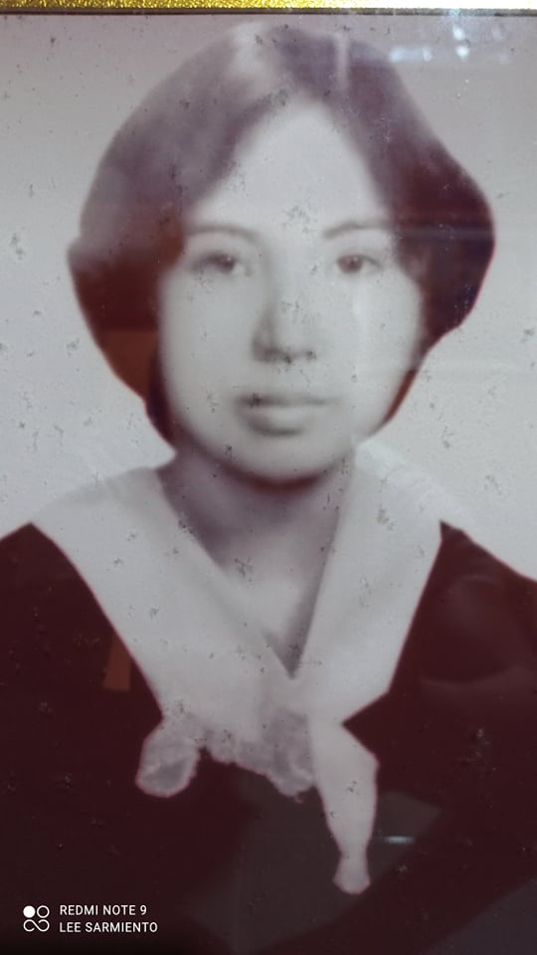
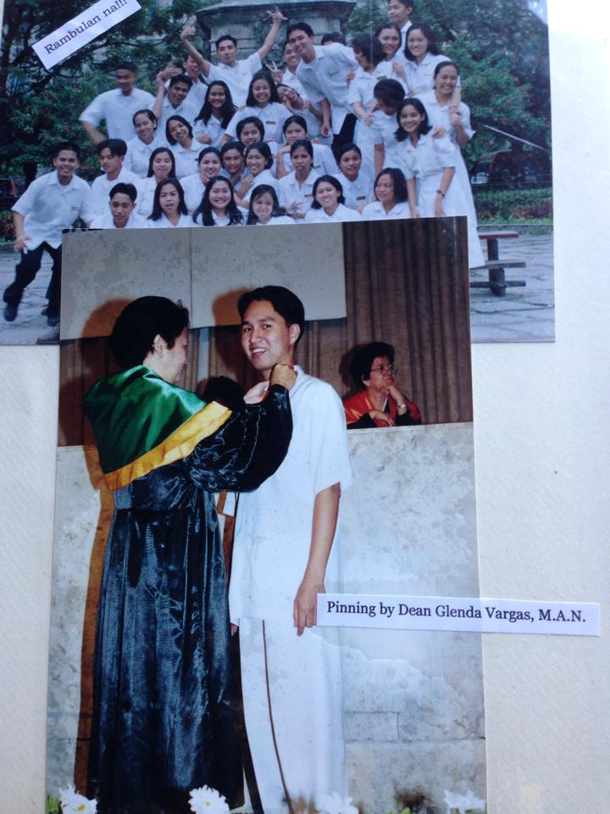
Why am I a Nurse?
Notes:
Who influenced me to go to nursing? Mom. Mom was a midwife, I grew up seeing her deliver babies at the health center and houses in the barrios.
My background - graduated with BSN at UST in 2001, I wanted to go to med school at UST but it was expensive. I am the eldest and my other siblings had to go to college as well.
I’ve worked as an RN in MS, HD (UST Hospital), Clinical Instructor (FEU), ER and ICU (AZ and CA).
Graduated from NP school at UCLA in 2016. Have worked in serving underserved population – HIV primary care.

Slide 6
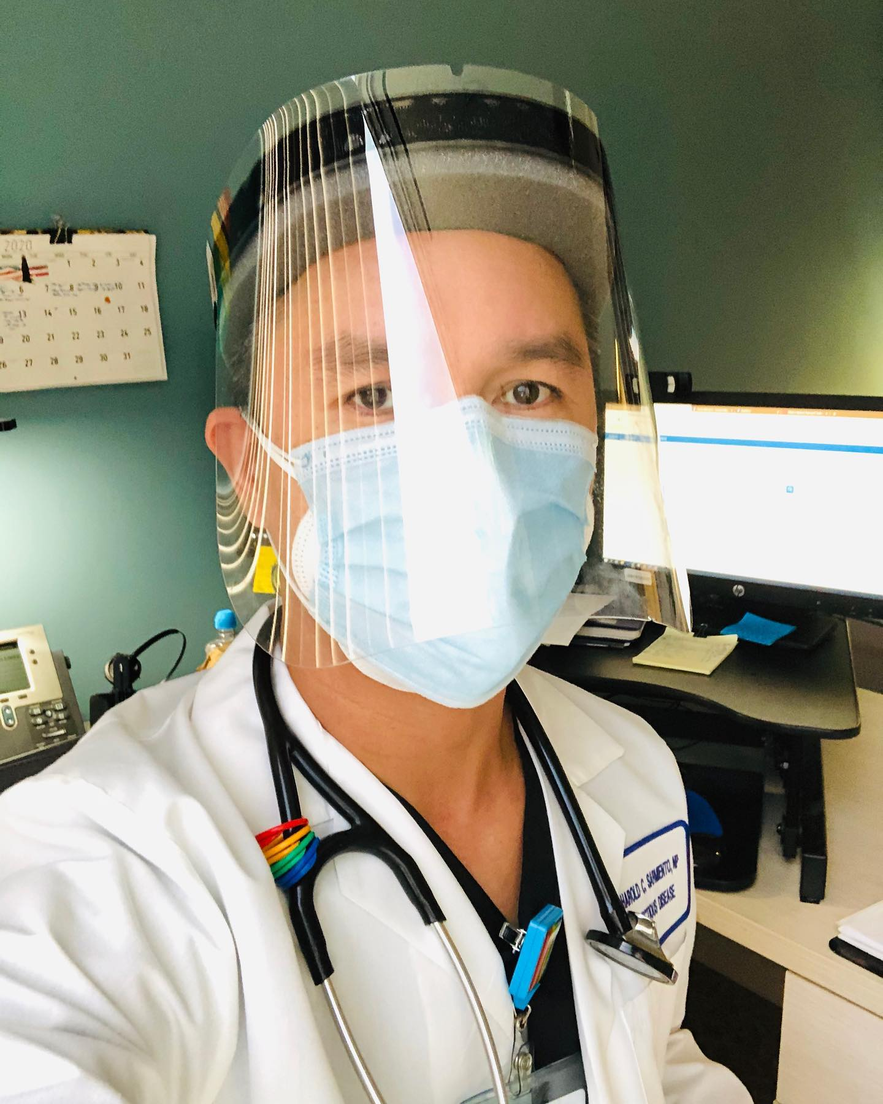
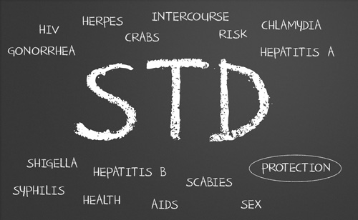
Why am I a Nurse?
Compassionate, inclusive and equitable care for the diverse LGBTQ community

Slide 7
Working in HIV and STD Prevention
What do I do every day?
What are my routines?
Types of patients that I see?
What are the changes in my practice brought about by COVID-19?
What do I think when leaving work?
Notes:
What do I do every day? PrEP and STD provider, also covering provider for outpatient infusion center
What are my routines? Starts 9am till 0530pm M-F, see 14-16 patients a day (in clinic and telemedicine), order and review test results, order treatment, call pts for abnormal test results, referral (HCV – GI), education and counseling in HIV and STD prevention, see walk in patients in HIV clinic
Types of patients that I see? Underserved LGBTQ population - patients who are at risk of contracting HIV and STIs – 90% MSM, IVDA, sex workers. Pts with diverse sexual interests and sexual practices. ID patients with latent TB.
Changes in my practice due to ÇOVID – increased in fears, anxieties and mental issues such as depression amongst my patients. Utilization of telemedicine via phone or video visit, providing patients 90 days of meds using mail order pharmacy, use of face shield, mask, focused assessment in clinic visit, seeing yearly instead of every 3 mos
What do I think when leaving work – fear of contracting COVID-19 and bringing it home to my family, infecting my mom who’s battling pancreatic cancer and my dad who’s hypertensive

Slide 8
Coping and Functioning Daily
Coping strategies
1. Practice self compassion
2. Mindfulness meditation – deep breathing, staying at the present. Worrying will not help or change the situation
3. Cognitive behavior skills – positive thoughts
4. Staying active – walking, cycling, exercise, gardening – relieve stress
5. Self care - eating healthy, getting enough sleep, reading a book, journalling.
6. Talking to friends/colleagues – get help for stress and anxiety as needed. Some employers provide mental help services for their employees
7. Take a break from media – fb, IG, internet or TV.
Notes:
* How do we deal when we learned about a colleague or loved one died of COVID-19?

Slide 9
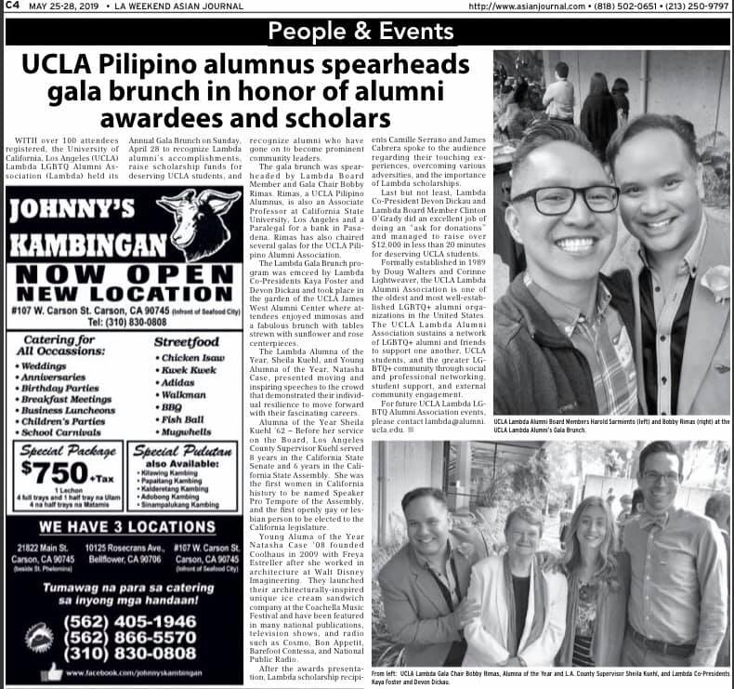
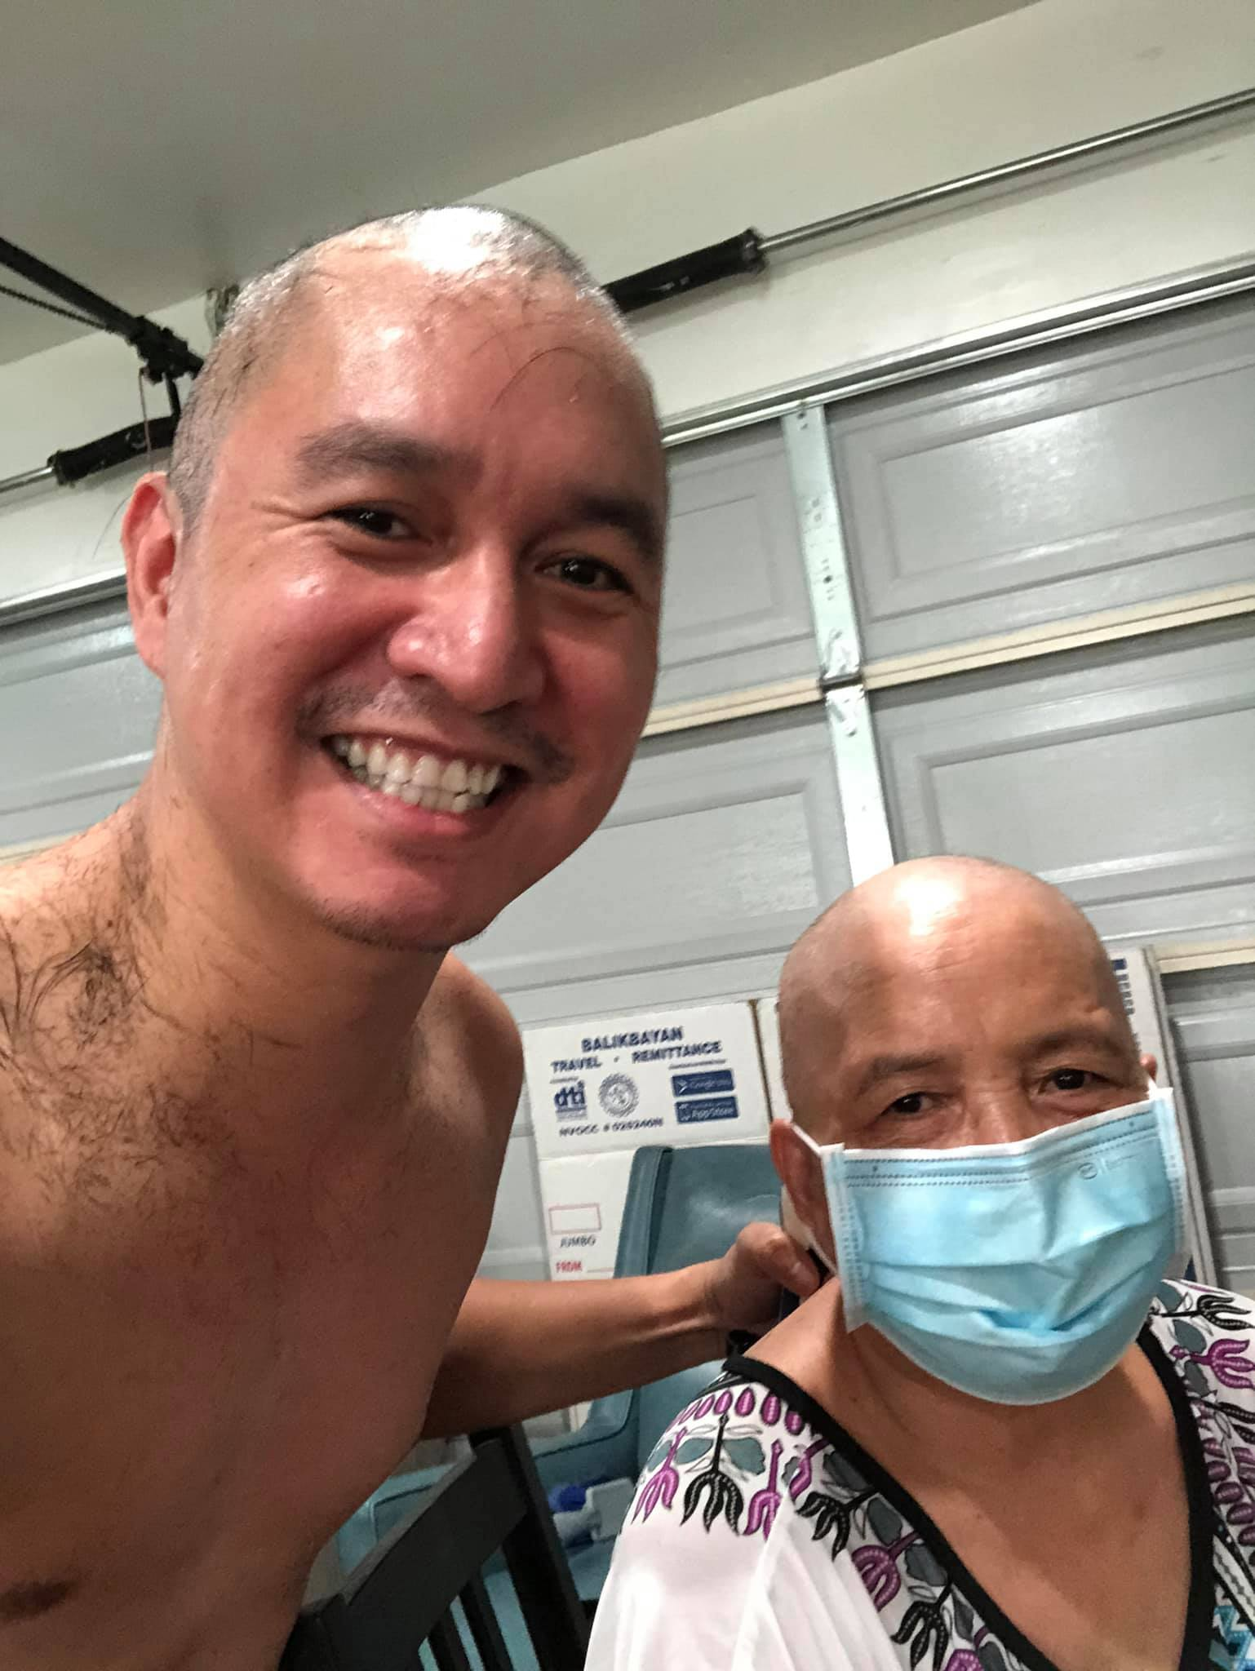
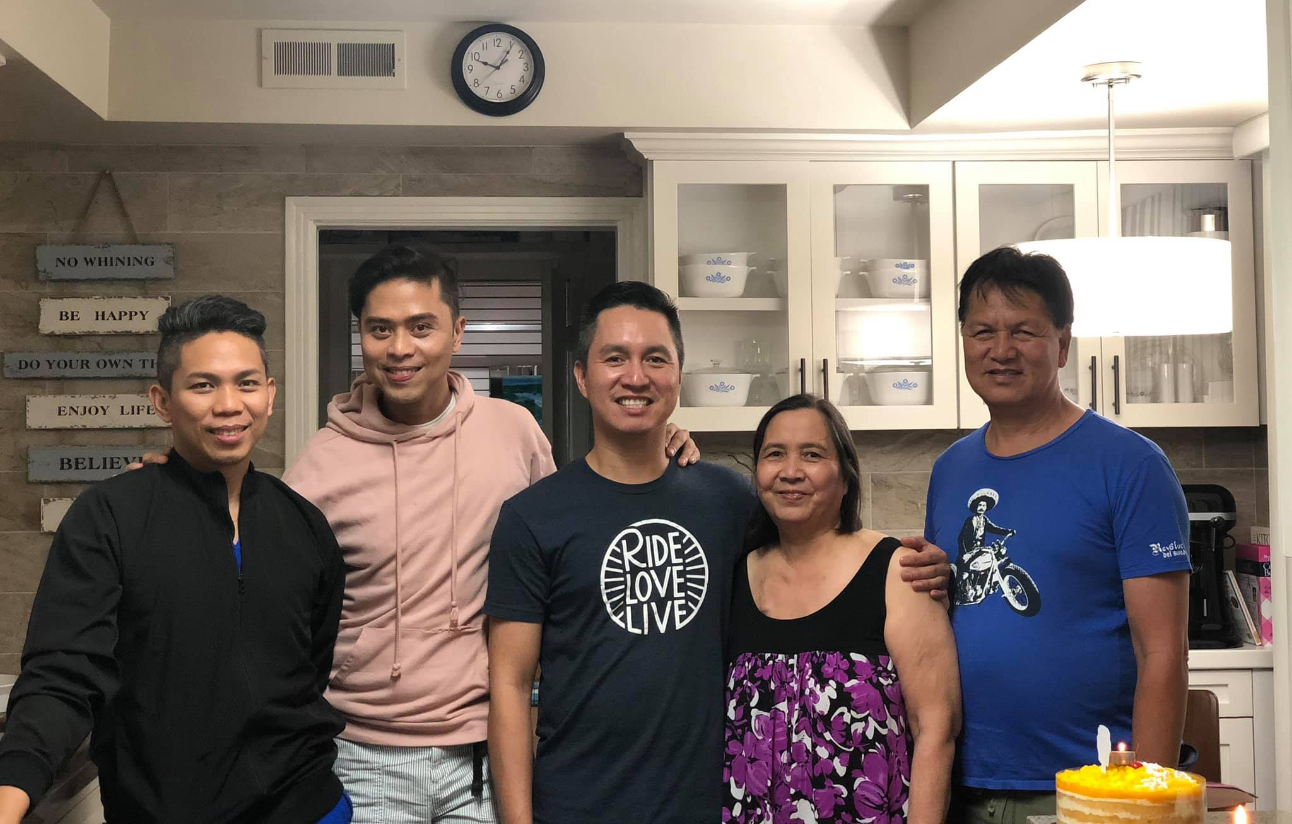
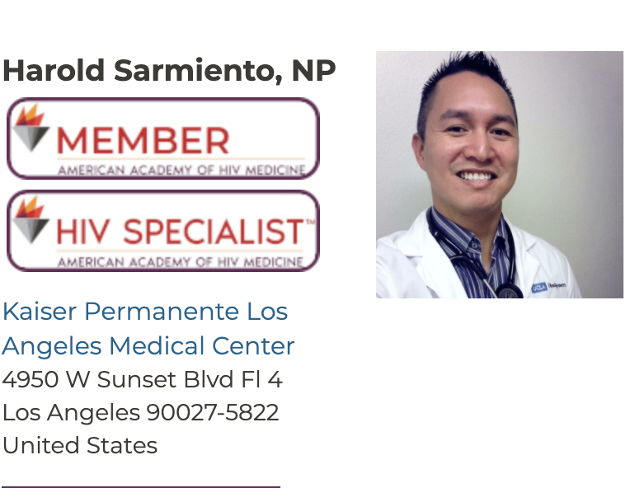
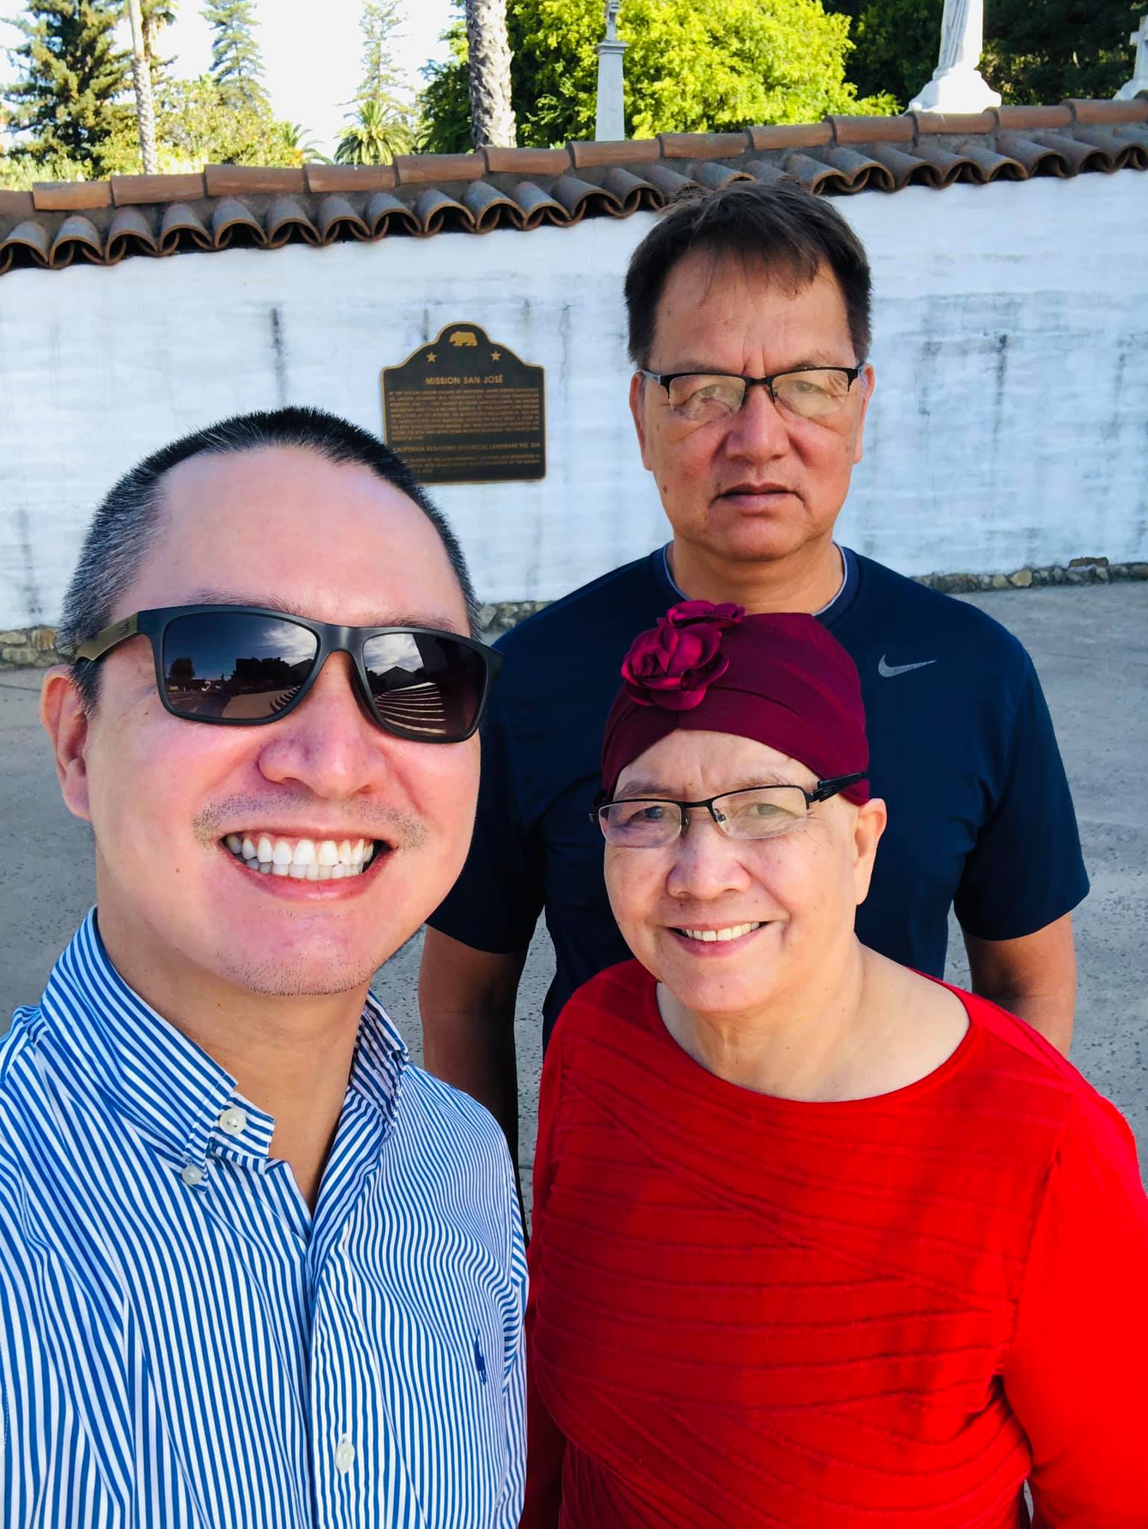
Bridging the academic, professional, civic, personal and intersectional identity.

Slide 10
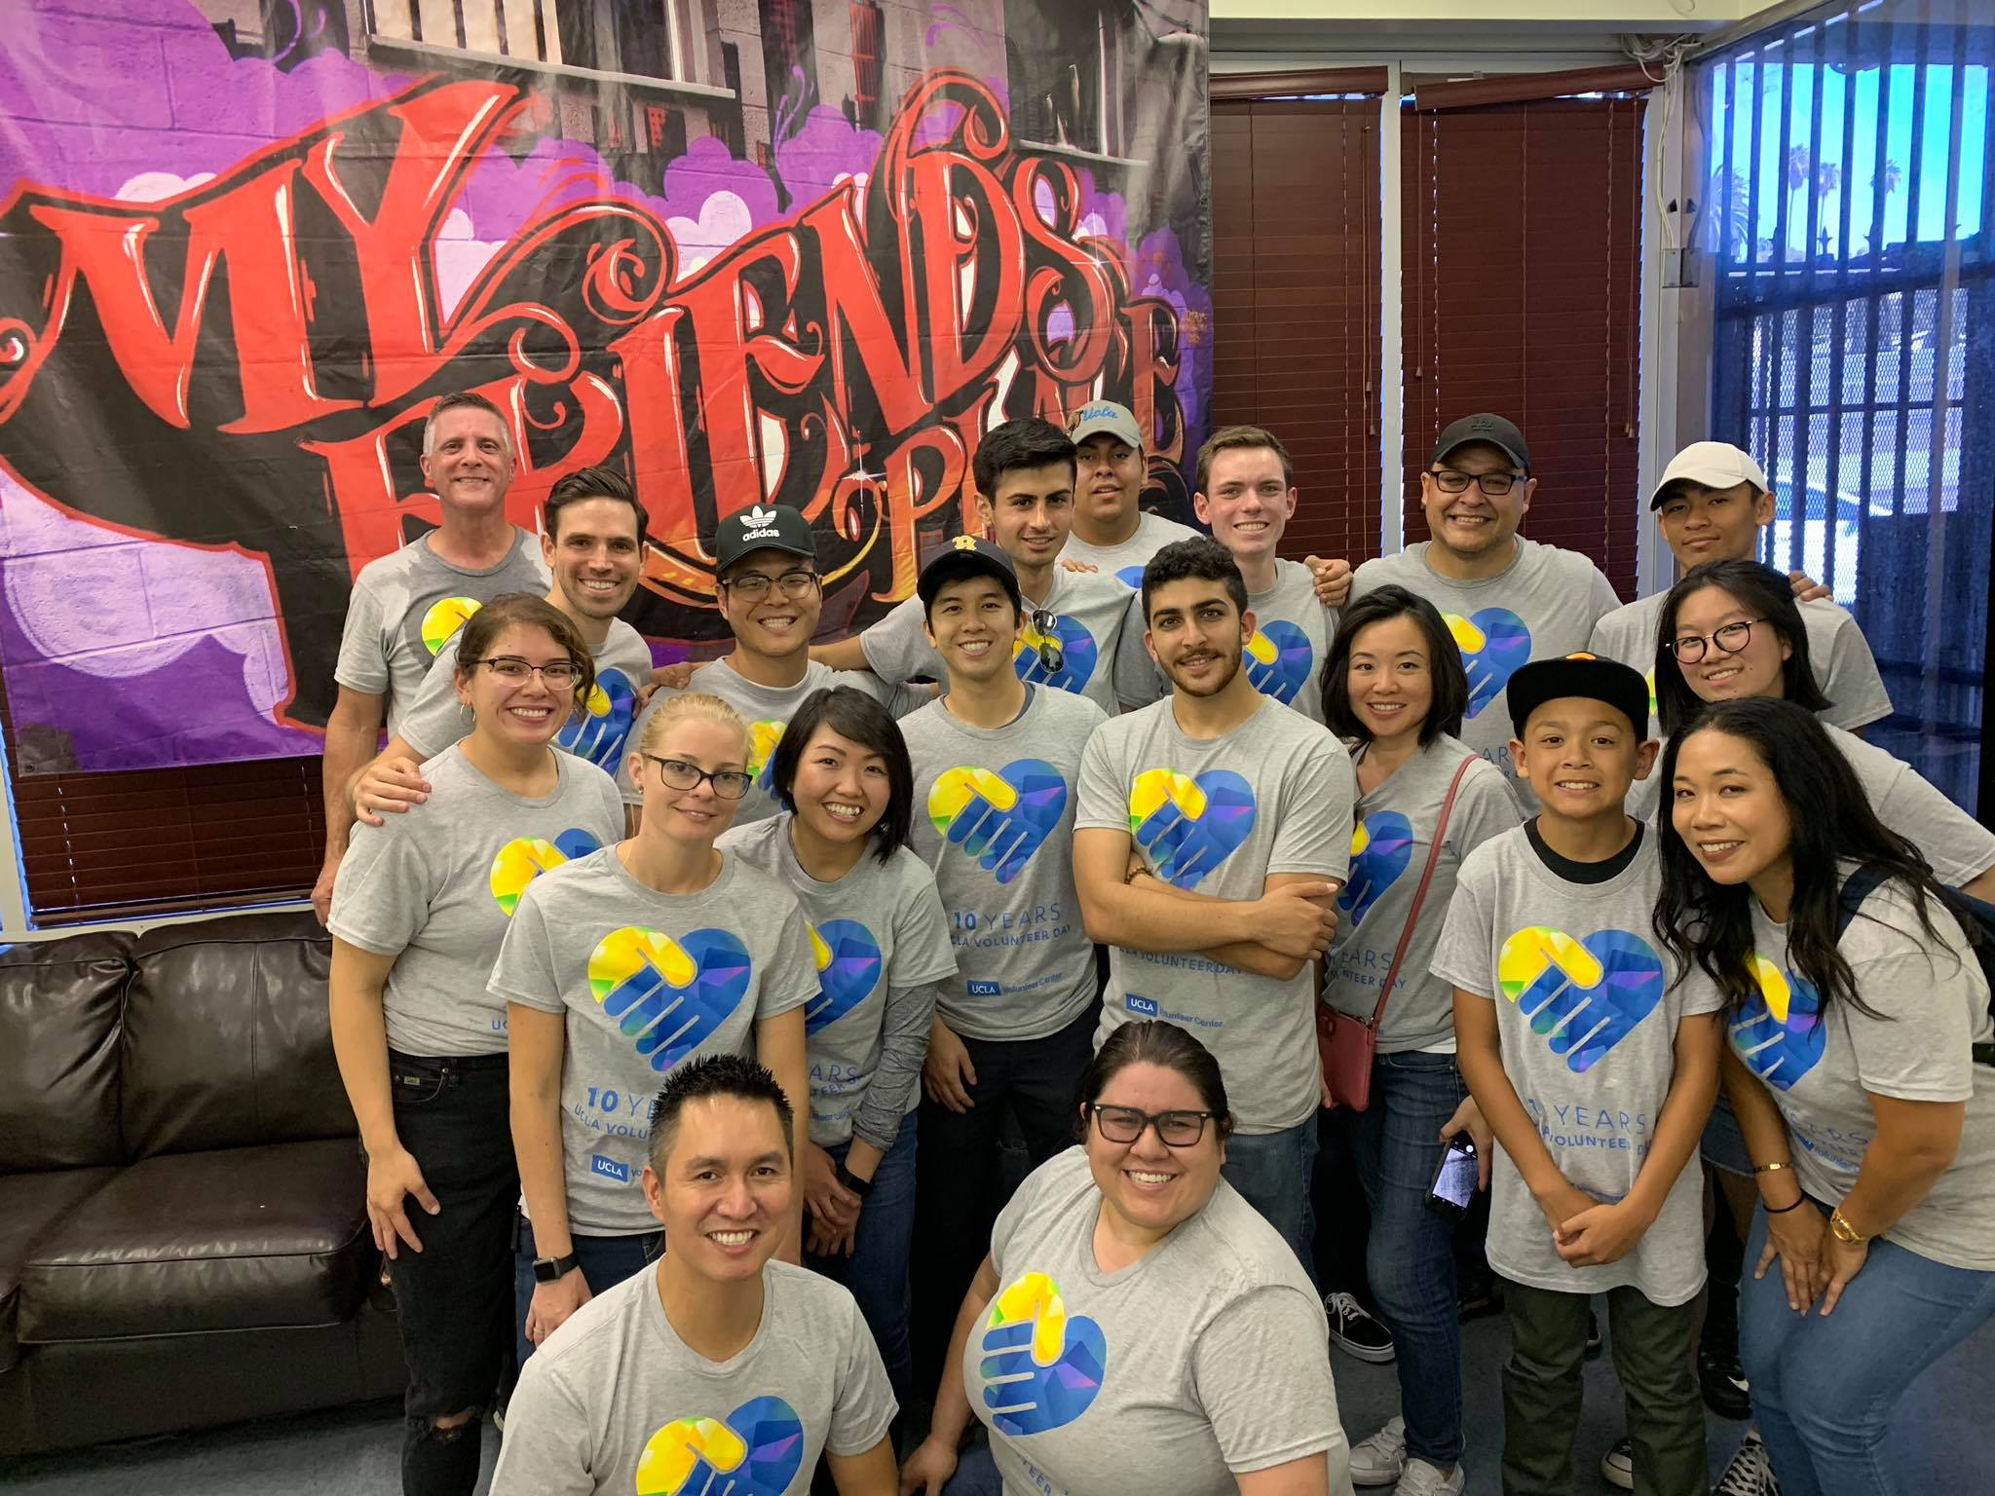
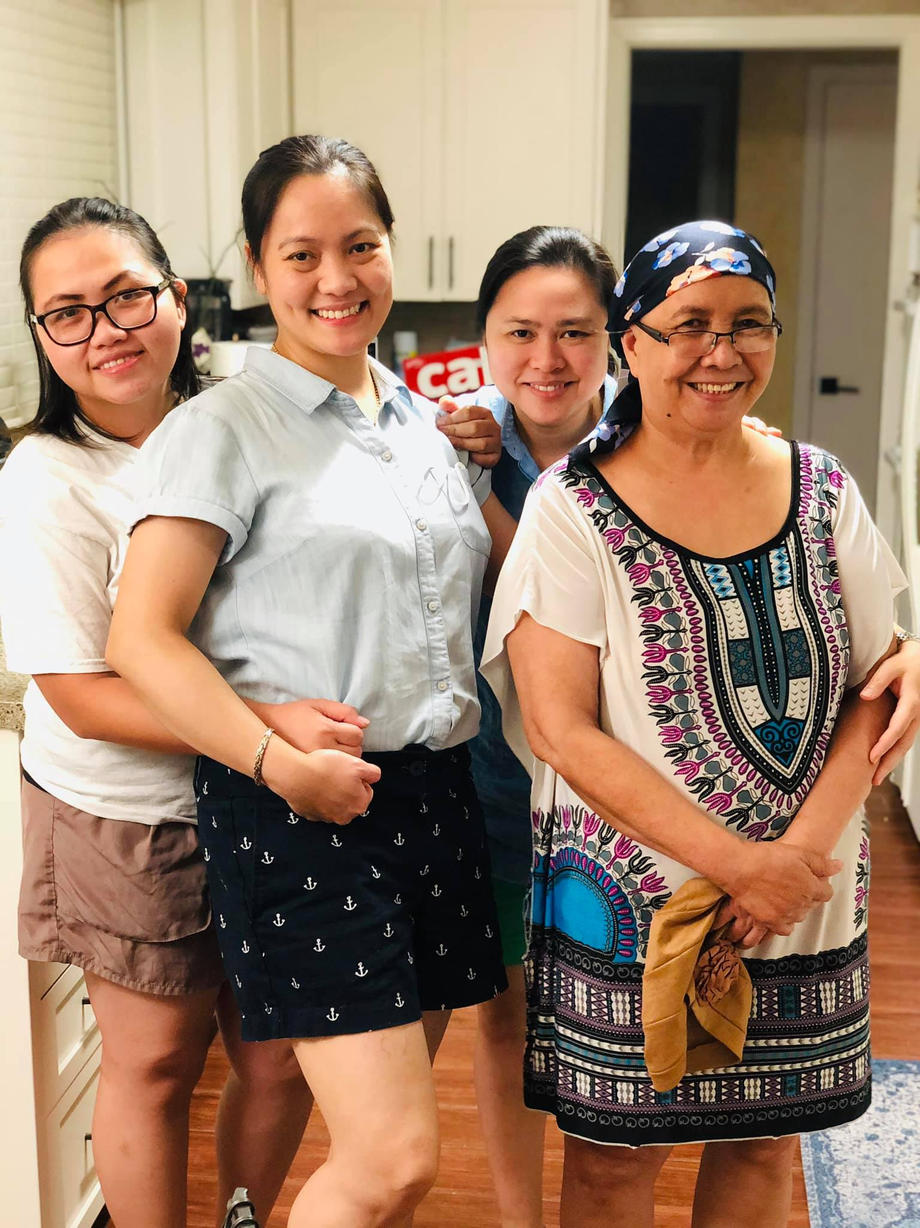

Slide 11
Are We Heroes?
Nurse Ranked Most Honest Profession 19 years in a row*
Isn’t it ironic that when we were supposed to celebrate this Year of the
Nurse in Jubilation- we the NURSES have been sent to the ultimate test of our profession, that is being in the frontlines unequipped with the basic tools of the trade. Just like soldiers in the frontlines equipped inferiorly, we delivered our usual day-to-day providing care.
Nurses’s experiences during COVID-19 visibly documented on news and social media, have raised public awareness of what we do daily. Such awareness has resulted public labelling of nurses as heroes.
Public recognizes nurses for our courage, bravery, commitment, knowledge, resilience, advocacy and persistence in the face of incredible adversity.
*Galluppoll2019
Notes:
Despite these, we have been subjects to discrimination in Careless and unkind remarks in the media not only by citizens but complicated by ignorant remarks by people in power.
As nurses, we do not consider ourselves as heroes but it is basic nursing core character of service.
a lot of places – people are staying away from you in public just because you are wearing scrubs, not being served or refused services, not being allowed to board public transportions, etc.

Slide 12
Relief in Sight
COVID-19 Specific Management - based on NIH and IDSA
THERAPIES, ANTIVIRALS & IMMUNOMODULATORS
Hydroxychloroquine (Plaquenil)
Multiple actions, prevents binding to ACE2, presents transport in endosome
400 mg po BID for 2 doses, then 400 mg daily for a total of 5 days
Key toxicity - QTc prolongation, check EKG
* No longer recommended outside context of RCT. A NEJM randomized trial showed that hydroxychloroquine did not prevent illness compatible with Covid-19 or confirmed infection when used as postexposure prophylaxis within 4 days after high-risk or moderate-risk exposure to COVID-19 (Boulware et al). No difference in 28 days mortality, associated with increased hospital stay, progression to intubation/death. Stopped early due to lack o benefit.
Azithromycin
Azithromycin is being studied but current results have shown no clear clinical benefit for the treatment of COVID-19.
*The [NIH] Panel recommends against the use of hydroxychloroquine plus azithromycin for the treatment of COVID-19, except in the context of a clinical trial (AIII).
Notes:
Consult ID before prescribing. There are no FDA approved therapies for COVID-19
At present, no drug has been proven to be safe and effective for treating COVID-19. There are insufficient data to recommend either for or against the use of any antiviral (e.g., hydroxychloroquine, chloroquine, remdesivir) or immunomodulatory therapy (e.g., IL-6 inhibitors, IL-1 inhibitors, convalescent plasma, hyperimmune immunoglobulin) in patients with COVID-19 who have mild, moderate, severe, or critical illness (AIII).

Slide 13
Corticosteroids - Dexamethasone (Decadron)
Decrease inflammation in the early stage of ARDS, if given early may decrease ICU length of stay and decrease number of days of mechanical ventilation.
Rx for hospitalized patients requiring supplemental O2 or mech vent, avoid for mild or moderate disease
6 mg po/IV once daily for up to 10 days
Monitor for hyperglycemia and reactivation of latent infections & viruses- check for latent TB, HBV, HSV, CMV and VZV
*On the basis of the preliminary report from the RECOVERY Trial (UK)
Remdesivir
Nucleotide prodrug that inhibits RNA-dependent RNA polymerase
Authorized by the FDA for emergency use on May 1, 2020 but limited in supply.
Adults & peds >40 kg NOT requiring mech vent ~ 5 days treatment course
Day 1 ~ 200 mg IV loading dose, Days 2-5 ~ 200 mg IV
Adults a& peds >40 kg requiring mech vent ~ 10 days
Day 1 ~ 200 mg/IV loading dose, Days 2-10 ~ 100 mg IV
Key toxicities – N&V, ALT elevations, caution for eGFR <30
*Given an FDA EUA granted on 5/1/2020 based on preliminary results of randomized placebo controlled trial ACTT-1 published in New England Journal of Medicine, Remdesivi
Notes:
*A meta-analysis of these trial results demonstrated that, compared with placebo, corticosteroid therapy reduced the risk of all-cause mortality (risk ratio 0.75; 95% CI, 0.59–0.95) and duration of mechanical ventilation (mean difference, -4.93 days; 95% CI, -7.81 to -2.06 days).^{14,15}
*Remdesivir is a nucleotide prodrug that inhibits RNA- dependent RNA polymerase, the enzyme that is necessary to copy the genetic information of SARS-CoV-2, the virus that causes COVID-19 • Inhibitors of viral polymerases are used against other viruses such as HIV, HCV, and herpesviruses. Remdesivir has activity against Ebola and other coronaviruses
Remdesivir directly slows down the part of the virus that makes new copies of itself • It is not yet proven to be helpful, but shows promise based on studies in the laboratory and it has been used for treating other viruses
Because remdesivir supplies are limited, the Panel recommends prioritizing remdesivir for use in hospitalized patients with COVID-19 who require supplemental oxygen but who do not require oxygen delivery through a high-flow device, noninvasive ventilation, invasive mechanical ventilation, or extracorporeal membrane oxygenation

Slide 14
*Convalescent Plasma
Plasma donated from individuals who have recovered from COVID-19 includes antibodies to SARS-CoV-2,1 and SARS-CoV-2 immune globulin is a concentrated antibody preparation derived from the plasma of people who have recovered from COVID-19. Both products may help suppress the virus and modify the inflammatory response.
Convalescent Plasma is being studied and clinical trials are being done
* FDA issued a n EUA on August 23, 2020
Tocilizumab (Actemra) and other IL-6 inhbitors
Monoclonal antibody to IL6 receptor
Recommended dose in adults:
50 – 60 kg: 400 mg single IV infusion
>60-85 kg: 600 mg single IV infusion
>85 kg: 800 mg single IV infusion
* Phase 3 RCT, hospitalized pt (COVACTA) – no difference in clinical status, ventilator free days or death by week 4, trends towards shorter hospital stay.
*Use of Tocilizumab within clinical trial for severely ill hospitalized pts due preferred due to limited data New England Journal of Medicine, Remdesivir (RDV) may be used for hospitalized adult or pediatric patients with severe COVID-19 disease.
Notes:
*There are insufficient data to recommend either for or against the use of convalescent plasma for the treatment of COVID-19.
Sarilumab and tocilizumab are both antibodies to the receptor for interleukin 6 (IL-6) • IL-6 is a protein that the body makes when it is inflamed
Sarilumab and tocilizumab do not block the virus directly • Sarilumab and tocilizumab are likely safe, especially with short-term use
In China, a group of 21 patients who received a drug called tocilizumab (similar to sarilumab) had improvement in their fevers, markers of inflammation and needed less extra oxygen. In the group who received that drug, there were no serious side effects seen • It is being studied to see if these drugs help people feel better faster, but their efficacy is unknown
The immune system may react strongly to the virus that causes COVID-19 * Part of that reaction includes a lot of a “cytokine” that is made by immune cells. Some think high amounts of this cytokine cause problems • Sarilumab and tocilizumab both directly block the effects of this cytokine
* nterleukin (IL)-6 is a pleiotropic, pro-inflammatory cytokine produced by a variety of cell types, including lymphocytes, monocytes, and fibroblasts. Infection by the severe acute respiratory syndrome-associated coronavirus (SARS-CoV) induces a dose-dependent production of IL-6 from bronchial epithelial cells.¹ COVID-19-associated systemic inflammation and hypoxic respiratory failure can be associated with heightened cytokine release, as indicated by elevated blood levels of IL-6, C-reactive protein (CRP), D-dimer, and ferritin.²⁻⁴ It is hypothesized that modulating the levels of IL-6 or its effects may alter the course of disease.

Slide 15
* Interferons (Alfa, Beta)
Interferons are family of cytokines with antiviral properties
Phase 2 RCT, n=101, inhaled IFN-beta-1a vs placebo for 14d, 79% reduction in progression to intubation or death, pts are twice as likely to recover.
* NIH recommends against the use of interferon for tx of covid-19 except in clinical trial.

Slide 16
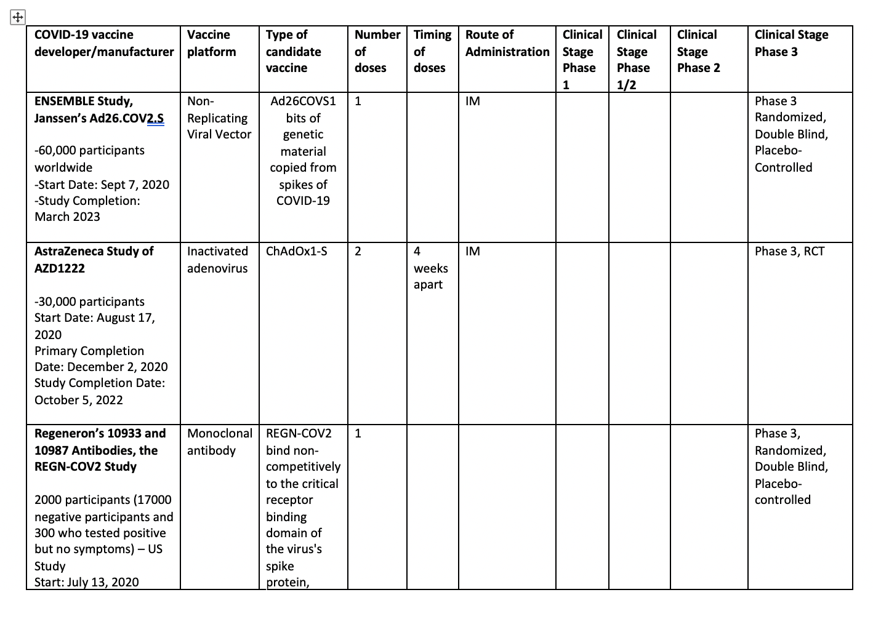
COVID-19 Vaccine Trials
Notes:
*The Ad26.COV2.S investigational vaccine includes bits of genetic material copied from the spikes of the SARS-CoV-2 virus.. The investigational vaccine does not contain the actual virus and cannot cause COVID-19.
*AZD1222 vaccine is based on a weakened version of a common cold (adenovirus) virus. The adenovirus vaccine has been changed so that it can’t replicate inside your body. It presents part of the COVID-19 spike protein to the body so that an immune response can be made to it. The purpose of the study is to test how well the investigational vaccine works at preventing COVID-19 disease and how safe it is.
** REGN-COV-2 is testing a combination of two antibodies called REGN10933 and REGN10987 to see whether they are able to prevent acquisition of SARS-CoV-2. This study will enroll approximately 2,000 adults in the United States who are living in the same household as a person who has recently tested positive for SARS-CoV-2.
The REGN10933 and REGN10987 antibodies are designed to bind to SARS-CoV-2 and prevent the virus from entering healthy cells. The antibodies were made in a lab by the pharmaceutical company Regeneron. REGN10933 and REGN10987 cannot give you SARS-CoV-2, nor will they make you sick with COVID-19.

Slide 17
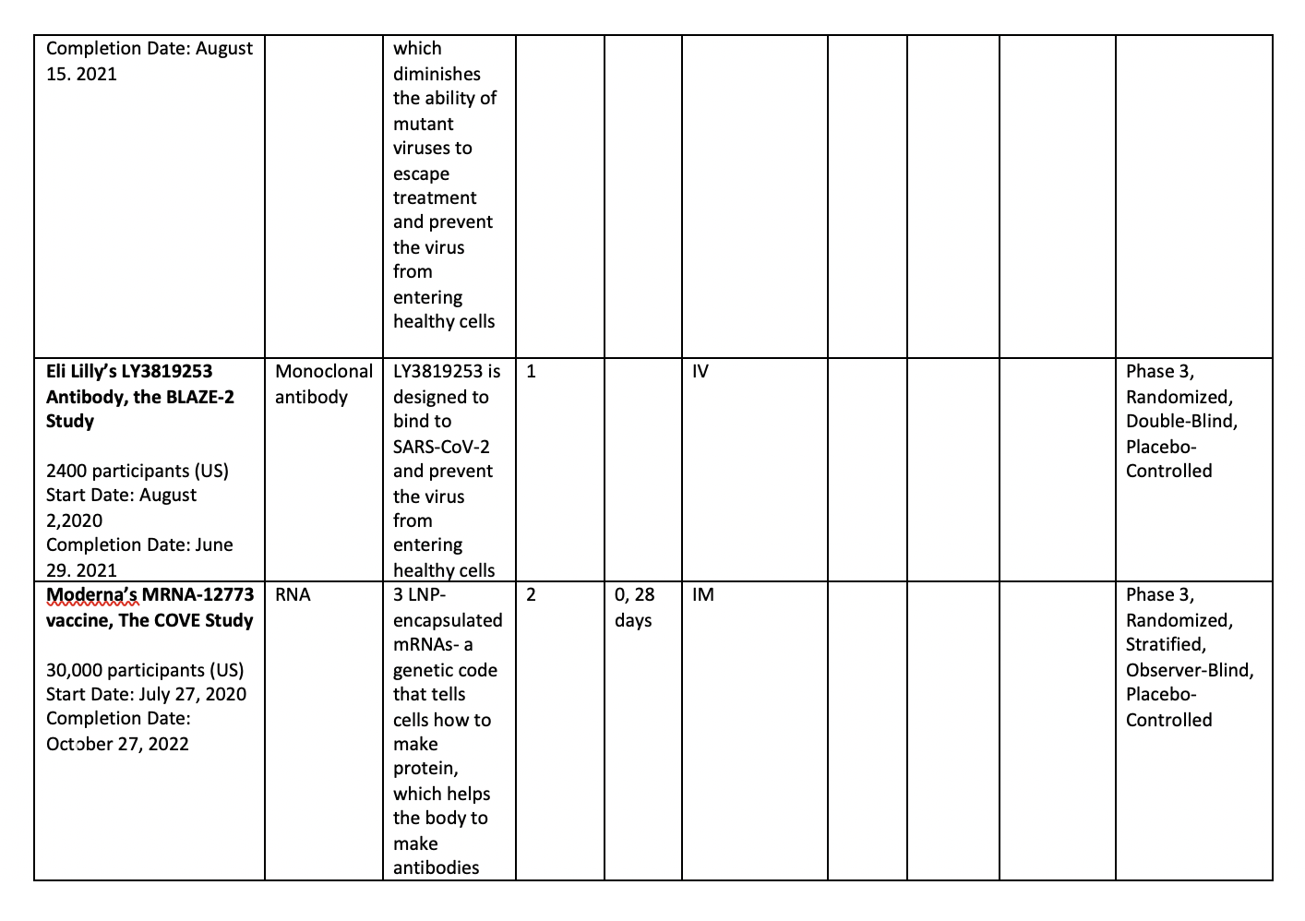
COVID-19 Vaccine Trials
Notes:
* BLAZE-2 is testing the LY3819253 antibody. It will be enrolling staff and residents in skilled nursing and assisted living facilities with a high risk of exposure to SARS-CoV-2. The study questions are:
Does the antibody prevent the acquisition of SARS-CoV-2?
Does the antibody help to prevent the development of more severe COVID-19, or does it reduce the symptoms?
LY3819253 is designed to bind to SARS‑CoV-2 and prevent the virus from entering healthy cells. LY3819253 was developed in a lab by the pharmaceutical company Eli Lilly. LY3819253 cannot give you SARS-CoV-2, nor will it make you sick with COVID-19.
* The mRNA-1273 vaccine is being developed to prevent COVID-19. The purpose of this study is to test Moderna’s vaccine candidate to see if it can prevent illness if people are exposed to the SARS-CoV-2 virus in their everyday lives. The mRNA-1273 vaccine is not made from the SARS-CoV-2 virus. It is made from messenger ribonucleic acid (mRNA), a genetic code that tells cells how to make protein, which helps the body’s immune system make antibodies to fight the virus. The vaccine cannot cause infection or make someone sick with COVID-19.

Slide 18
COVID-19 Vaccine Trials
Notes:
** This is a Phase 1/2/3, randomized, placebo-controlled, observer-blind, dose-finding, vaccine candidate-selection, and efficacy study in healthy individuals. The study consists of 2 parts: Phase 1: to identify preferred vaccine candidate(s) and dose level(s); Phase 2/3: an expanded cohort and efficacy part.
The study will evaluate the safety, tolerability, and immunogenicity of 2 different SARS CoV 2 RNA vaccine candidates against COVID 19 and the efficacy of 1 candidate:

Slide 19
Challenges in Vaccines
Is immunity to COVID-19 short-lived? Should we worry?
Most vaccines are aimed to generate a better antibody or immune response
Correlate of protection: an immune response statistically correlated with protection from infection or disease
The higher the antibodies, the higher the level of protection
Age affects how well a vaccine works – older have lesser immune response, lesser protection
Testing vaccine efficacy
50% at minimum according to FDA & WHO
At least 70% preferred efficacy
Who will get the vaccines first?
Priority group – those who have the highest risk of exposure and those who are at risk for severe morbidity and mortality – half of US adults and frontline workers
Distribution? States that are heavily affected? Wallgreens
Forced or Mandatory Vaccination? – no existing law
Anti-vaxxers?
Mistrust of the pharma industry and government
Conspiracy theories and misinformation campaigns

Slide 20
The 7 Cs of Resilience
1. Control – we can only control ourselves and what we do
2. Competence – staying updated on the disease process and management is essential
3. Coping – recognize how we cope and take time to cope
4. Confidence – be confident that this we will get through this. Build confidence among your colleagues, praise or celebrate success (pt’s discharge from ICU) or providing encouragement
5. Connection – our own connection with family and friends (Zoom, video calls, tech)
6. Character – our integrity and commitment to care exemplify our profession
7. Contribution – we are making a difference. Be proud of your work!
* Ginsburg, K.R. (2011). Parent’s Guide to Building Resilience in Children and Teens: Giving Your Child Roots and Wings

Slide 21
Recommendations
GIVEN THE PRACTICE ENVIRONMENT OF THE COVID-19 PANDEMIC, NURSES SHOULD CONSIDER THESE POINTS:
During the pandemic, we nurses must decide how much quality care we can provide to others while also taking care of ourselves and our loved ones.
There maybe times when an RN must make a choice based on moral grounds in order to maintain professional integrity.
RNs may struggle with the call to volunteer and respond in pandemic. We may choose not to respond if:
vulnerable group, we feel physically unsafe due to lack of PPE, inadequate support for meeting out personal and family needs, or we are concerned about professional, ethical and legal protection for providing care to COVID-19 pts.
Organizational support for RN is a non-negotiable necessity. We must not be retaliated for raising concerns.
We are responsible for being knowledgeable about state law which we practice during a pandemic.
We are stakeholders in developing and implementing policies re: standards of care during COVID-19 pandemic.
Employers have the responsibility to create, maintain and provide practice environments that help the medical needs of our community within a system that protect nurses through provision of PPE, immunizations, physical security and operational protocols
*Code of Ethics for Nurses with Interpretive Statements, ANA

Slide 22
I Believe We Are Heroes: We Are in this Together
COVID-19 pandemic experience epitomizes threat to human health. Historically, we have always served as advocates and warriors for social justice. Now it the time to revisit and reinforce our professional commitment to being advocates for patients and our communities.
It is time to take risks by voicing loudly issues threatening patient safety in healthcare organizations and in the larger public arena.
It is time to confront elected officials about their commitment to addressing the social determinants of health and social justice.
It is time for nurses to be politically sophisticated (Jaurigue & Schmidt, 2020), to seek and serve on district, state or national organizations, to run for political office.
Nurses during COVID‐19 demonstrated unwavering courage—that courage needs to be made operational through political activism. To do less devalues our commitment! Yes, We are Heroes!

Slide 23
Thank you!
Questions?
harcsarm@ucla.edu

