Slide 1
A Healing Journey Through COVID-19: Then and Now
Kathleen MacKerrow, MS, RN, GCNS-BC, DSD
Geriatric Clinical Nurse Specialist, Laguna Honda Hospital & Rehabilitation Center
Volunteer Clinical Faculty, University of California, San Francisco
Presentation to the Philippine Nurses Association

Slide 2
Objectives
By the end of the presentation, the participant will be able to;
Continue to maintain awareness of the impact of COVID-19 for persons who work in healthcare settings
Briefly review the potential systemic effects of COVID-19
Become familiar with a nurse’s personal story of what is was like then, and what it is like now
Enhance understanding of the term “long-hauler” and the impact on COVID-19 survivors
Identify educational and supportive COVID-19 resources
Identify 2 ways to ‘turn lemons into lemonade’ after surviving COVID-19 (resilience)

Slide 3
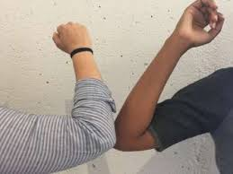
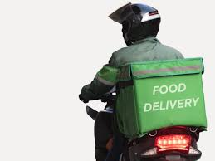
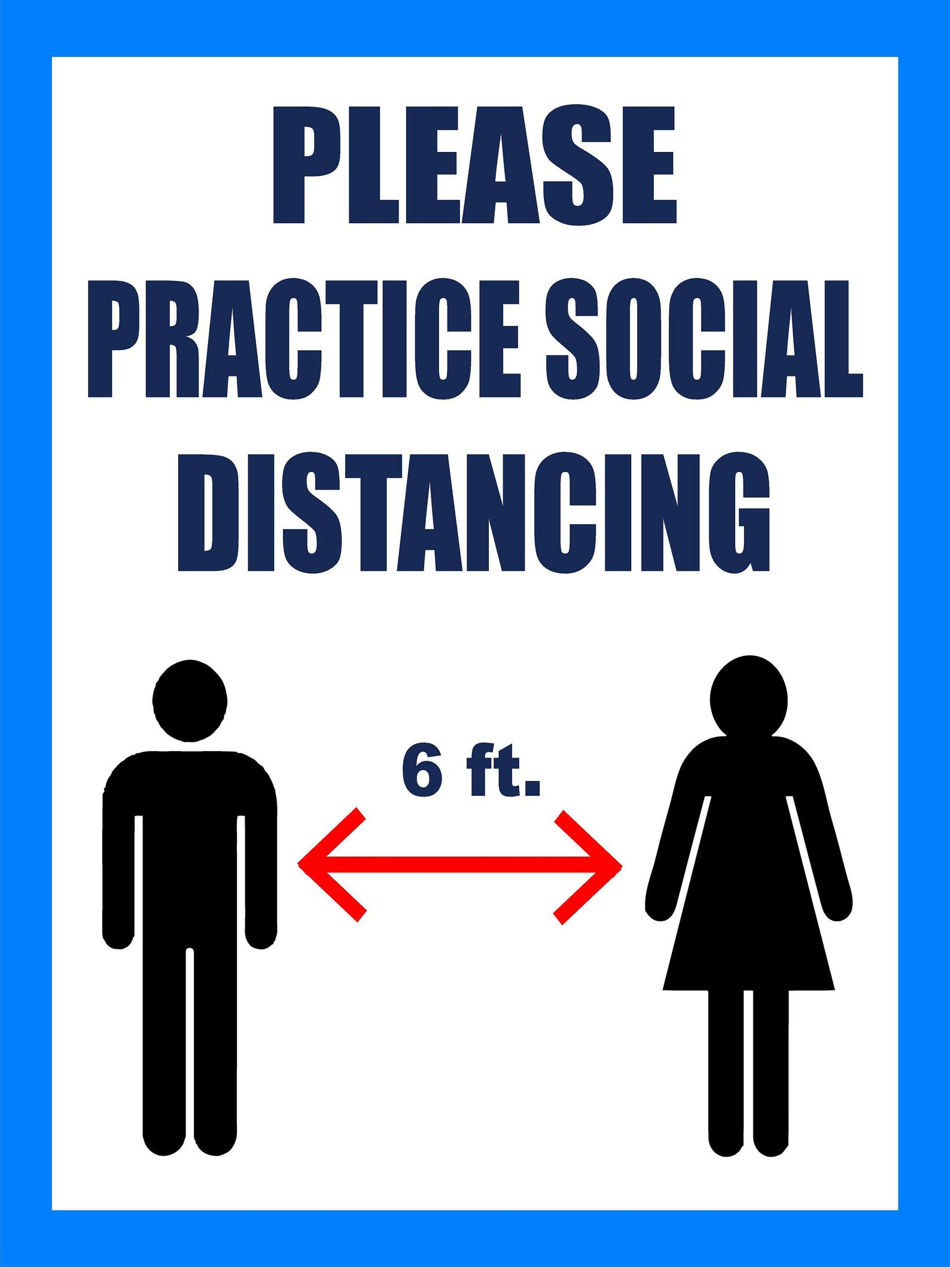
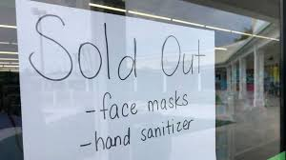
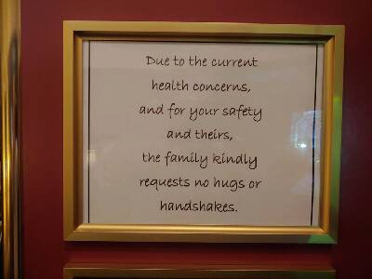
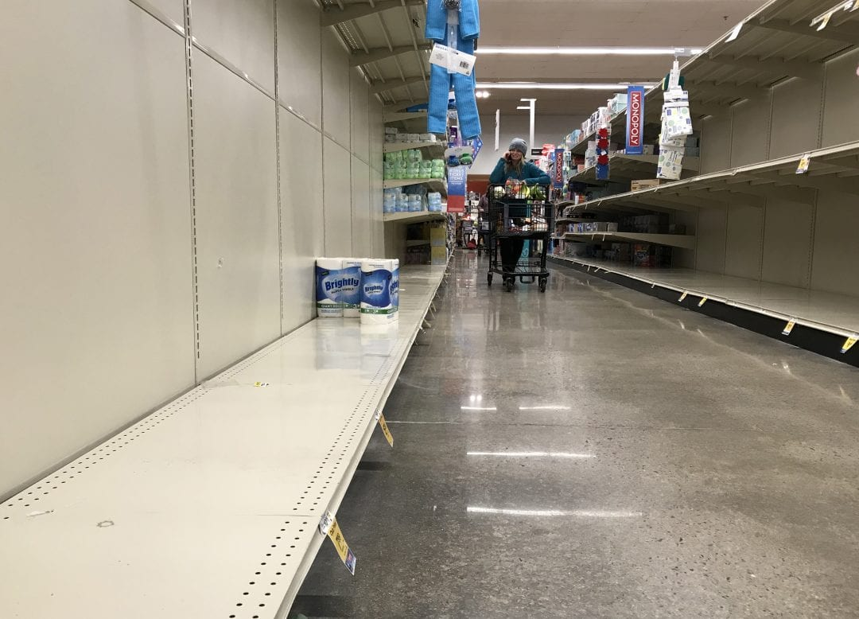
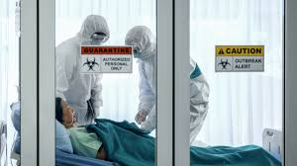
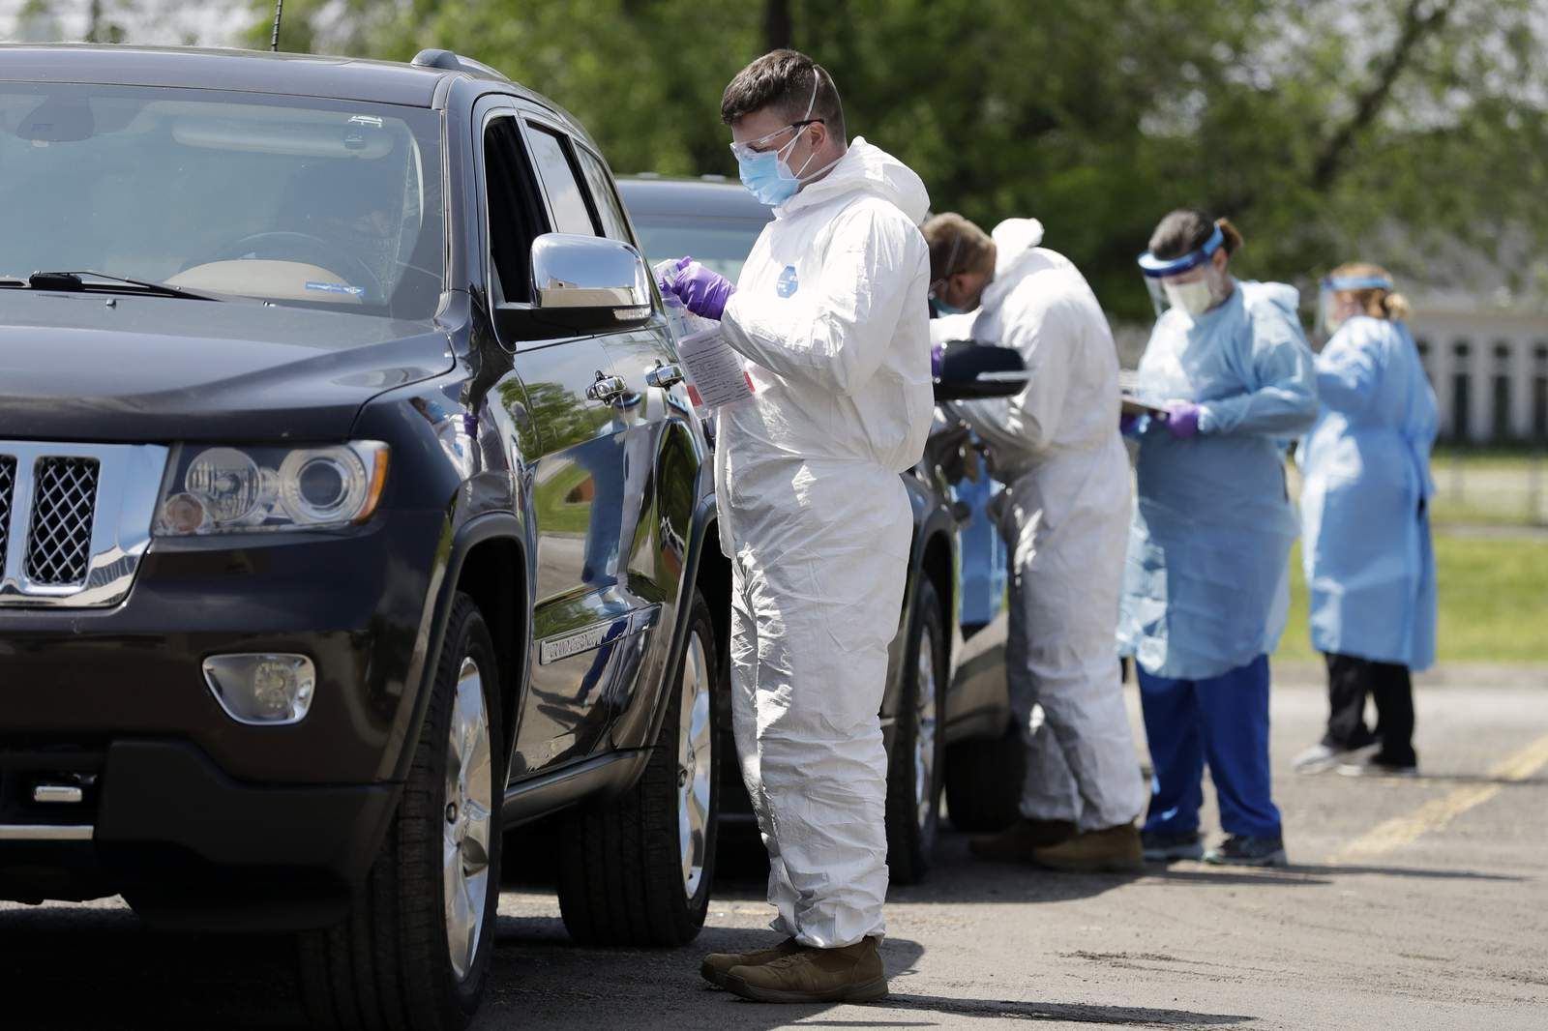
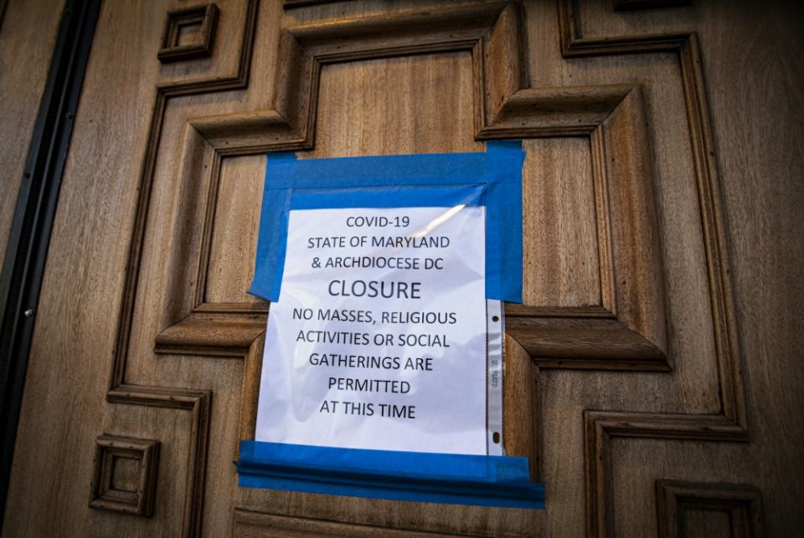
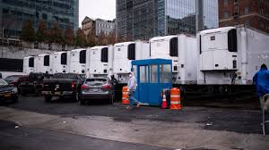
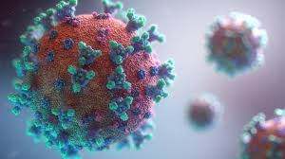
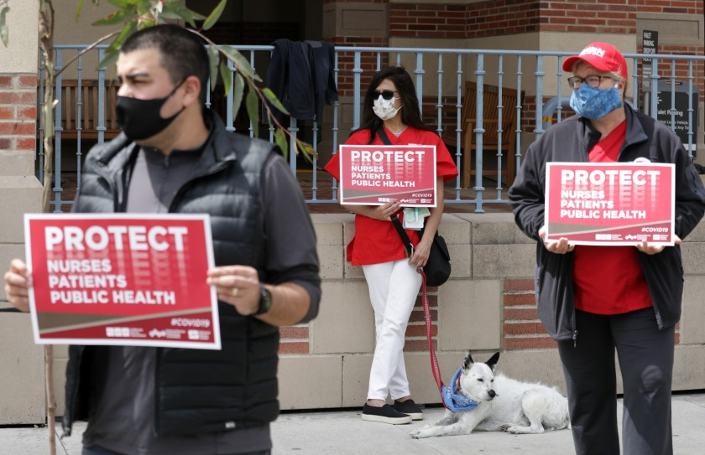
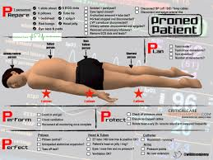
2020: A Year In Review

Slide 4
2020: We Couldn’t Fully Anticipate the What-Ifs

Slide 5
United States COVID-19 Cases & Death Reported to the CDC since 1/21/2020
Source: Centers for Disease Control (CDC), accessed 10/25/2020 at:
https://covid.cdc.gov/covid-data-tracker/#cases_casesper100klast7days

Slide 6
US COVID-19 Case Rate Reported to the CDC in the Last 7 Days, by State/Territory (cases per 100K)
Source: CDC, 10/25/2020

Slide 7
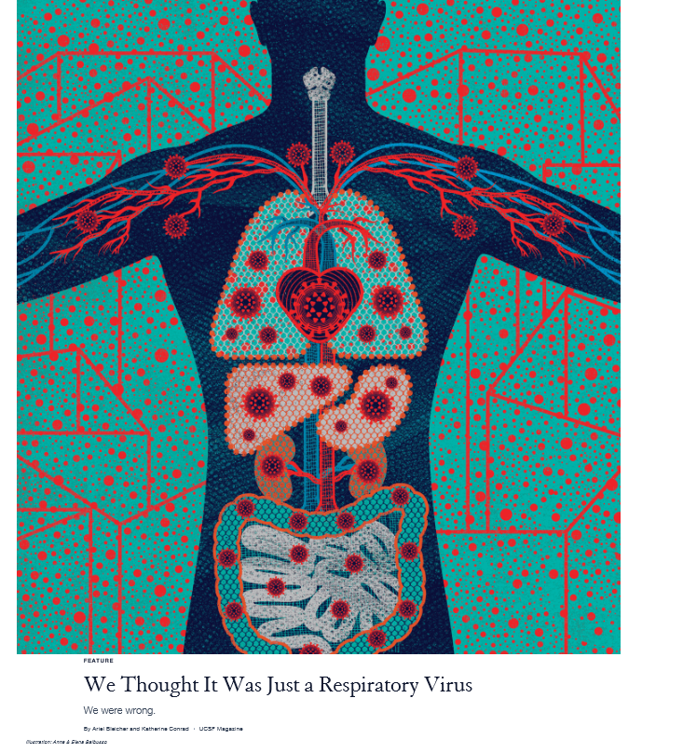
UCSF Studying the Pathophysiology: It’s Not Just a Respiratory Virus
Pathophysiology of how the infection begins
Impact on the;
Respiratory System
Cardiovascular System
Gastrointestinal System
Genitourinary System
Neurological System
Skin
Eyes
Endocrine System
Mental Health
No one case is exactly the same regarding symptoms, severity, and duration
Source: https://www.ucsf.edu/magazine/covid-body

Slide 8
COVID-19 Risk Factors for Severe Illness
People of any age with certain underlying medical conditions are at increased risk for severe COVID-19 illness
Five underlying medical conditions that increase the risk for severe COVID-19-associated illness
Chronic Kidney Disease,
Lung Disease (e.g., COPD, asthma)
Heart Disease
Diabetes
Obesity
These conditions are not only present in our patients we care for, but many healthcare workers also have these risk factors
Especially concerning in nursing due to an aging workforce

Slide 9
United States: Healthcare Personnel Cases & Deaths
Source: CDC, accessed 10/25/2020
https://covid.cdc.gov/covid-data-tracker/#health-care-personnel

Slide 10
A PERSONAL JOURNEY WITH COVID-19 The following information will be shared not to create fear, but to raise awareness for healthcare workers about the risk of COVID-19, recognition of it, action at the first sign/symptom of the virus, and some of the challenges that might be faced in the journey of healing. The information will also be useful to help you with family members, friends, coworkers, and the patients you care for who might be affected by COVID-19.

Slide 11
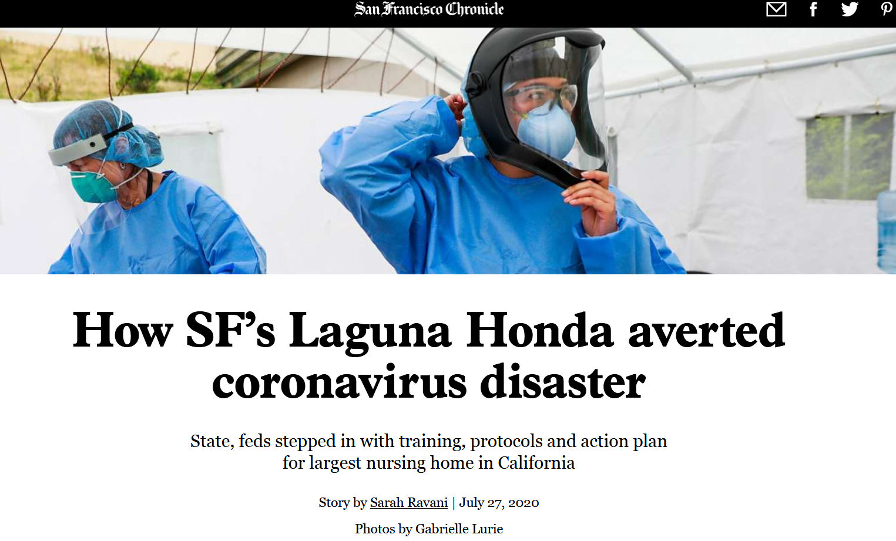
Hospital’s Quick Response to Pandemic: Protecting Patients and Staff

Slide 12
Clarifying Questions Before We Begin
Q: Where and how did I catch COVID-19?
A: I do not know. A thorough contact tracing could not determine the exact time/situation when I acquired it.
Q: Do I live by myself?
A: Yes. I live by myself and did not have anyone in my home during the shelter-in-place period.
Q: Was I careful about infection control practices including wearing a mask, social distancing, and handwashing prior to catching COVID-19?
A: Very much so that people teased me about how much cleaning I was doing
Q: Did I have risk factors that would make it more severe if I caught COVID-19?
A: Yes (heart, respiratory, overweight)
Q: Did I think I would catch it?
A: Nope. I was extremely careful and thought I’d be safe.

Slide 13
Timeline of Onset & Symptoms
Mar 24-25 | Mar 26 | Mar 27 | Mar 28 | Mar 29 | Mar 29 – Apr 3 | Apr 3 – May 4
Sneezing and felt like allergies | Sneezing 12 Noon-Loss of taste and smell (feeling like I was coming down with a “virus”) Left work immediately | Never felt feverish In contact with MD late afternoon To get tested on Saturday Started feeling “winded” with any activity | Tested first thing in the morning at a drive-through clinic High fever, but I didn’t feel feverish O2 sat a little lower than normal Took me about 30 minutes to get up 3 flights of stairs at home Severe dyspnea on exertion Started to get mild GI symptoms | Couldn’t eat and only able to drink liquids Nausea Vomiting Severe diarrhea Severe dyspnea Contemplating how to get to the ED MD called and informed of (+) result Instructed to go outside and call 9-1-1 To CPMC ED Admitted to COVID-19 unit | Thorough contact tracing completed Could see changes on CXR Low WBC count High CRP Severe symptoms Joint and bone pain Dyspnea GI Mouth inflammation Vision change Did not require O2 beyond the 1st day Plaquenil, Zinc, Azithromycin treatment | On full quarantine at home Difficulty with ADLs Isolated Fearful Symptoms continued: Pain Vision Dyspnea GI Weight loss Severe fatigue Brain fog

Slide 14
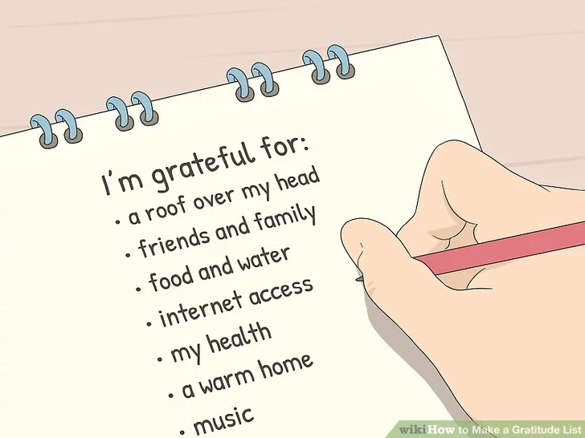
Hospitalization Highlights
My nurses and physicians, especially my day shift nurse (a new- graduate nurse being precepted)
My nurses preventing me from watching TV – no TV was allowed
Too much sad news to see
Rest and more rest
Triple treatment trial
Prayer and meditation
Daily gratitude list

Slide 15
What is Post COVID-19 Syndrome
Post COVID-19 syndrome is also know as “long-haulers”
Long-haulers are people who have not fully recovered from COVID-19, weeks or even months after first experiencing symptoms
The syndrome refers to the constellation of symptoms long-haulers are experiencing
Heart-postural orthostatic tachycardia
Lung-chronic cough, dyspnea
Kidneys
Gastrointestinal tract
Chronic fatigue
Chronic pain-muscle, joint, and headache
Brain fog
Endocrine
Other: vision changes, skin changes, hair loss
Cause is being studied-inflammatory damage to organs is a possibility
As healthcare professionals, we need to be sensitive to the “invisible disabilities” that many of our coworkers, family, friends, and/or patients may have post COVID-19 infection

Slide 16
Turning Lemons Into Lemonade (Resources for All): Survivor Corps
https://www.youtube.com/watch?v=qy2u-0IvmeY
Source: Survivor Corps https://www.survivorcorps.com/

Slide 17
Get Involved: Research Study Opportunities
Rise Above COVID-19 Research Opportunities Site
https://www.riseabovecovid.org/en/?gclid=EAIaIQobChMIs_ia9KjR7AIVKB6tBh2vggXOEAAYASAAEgI1r_D_BwE&gclsrc=aw.ds
UCSF COVID-19 Research Opportunities
https://clinicaltrials.ucsf.edu/covid-19

Slide 18
Support and Education
On-Line Support Group: Body Politic https://www.wearebodypolitic.com/covid19
Facebook-Survivor Corps Group (very educational and supportive): https://www.facebook.com/groups/COVID19survivorcorps/
Bay Area Council, COVID-19 Response and Resource Network: https://www.bayareacouncil.org/covid19/
Mental Health Association of San Francisco (24/7 support) https://www.mentalhealthsf.org/
UCSF Department of Psychiatry and Behavioral Sciences: https://psychiatry.ucsf.edu/copingresources
Check you local health system for post COVID-19 follow-up clinics

Slide 19
References
Paul, H.T. (2020). Covid-19 long-haulers and the experience of ‘hidden’ disabilities. STAT News. Accessed at https://www.statnews.com/2020/10/07/covid-19-long-haulers-experience-hidden-disabilities/
Rubin, R. (2020). As their numbers grow, COVID-19 “long-haulers” stump experts. JAMA. 2020;324(14):1381-1383. Accessed at https://jamanetwork.com/journals/jama/fullarticle/2771111
Bleicher, A. & Conrad, K. (2020). We thought it was just a respiratory virus: We were wrong. UCSF Magazine. Accessed at https://www.ucsf.edu/magazine/covid-body

